Slide 1
Microsoft Teams
Senaj Lelic
Trainer
WW Education
A hub for teamwork in Office 365

Slide 2
Agenda
Hub For Teamwork
Customer Success
Extensible Platform
Microsoft Teams Demo
Opportunity
Next Steps

Slide 3




Microsoft Teams momentum
ENG
ENG
CHI
CHI
SPA
US
UK
SIMP
TRAD
ES
SPA
FRA
FRA
DEU
ITA
MX
FR
CA
RUS
POR
POR
JPN
KOR
BR
PT
DUT
DAN
SWE
FIN
NOR
BOK
JAN ‘17
MAR ‘17
SEP ‘17
NOR
TUR
CZE
POL
THA
NYN
200k
181
25
100m
Organizations use
Markets
Languages
Office 365 active users

Slide 4





Celebrating 1 year of Microsoft Teams
3m
200k
70%
39
181
In the past year, 3 million teams have been created
Organizations are using Teams
of Skype for Business enterprise customers are using Teams
Teams is available in 39 languages
Teams users span 181 markets across the globe

Slide 5




A Hub For Teamwork in Office 365
Chat, calls & meetings for today’s teams
Integrated with Office 365 apps
Customizable & extensible
Enterprise security, compliance & manageability
Communicate in the moment and keep everyone in the know.
Give your team built-in access to applications they need in Office 365.
Tailor your workspace to include apps and services for the team and organization.
Get the enterprise-level security and compliance features you expect from Office 365.

Slide 6






Extensible Platform
Bots
Tabs
Help users get tasks done in conversations
Surface rich content within Teams
Extensible Platform
Build apps with a rich set of capabilities to enable these higher performing teams and reach your users in their chats, channels, notifications, and personal workspace.
Drive engagement by submitting your app to the Office Store.
Connectors
Activity feed
Post rich updates to channels
Engage users via feed notifications
Personal apps
Messaging extensions
All content across all teams and channels in one place
Allow users to query and share rich cards in conversations

Slide 7
Contoso in Microsoft Teams

Slide 8
Store

Slide 9
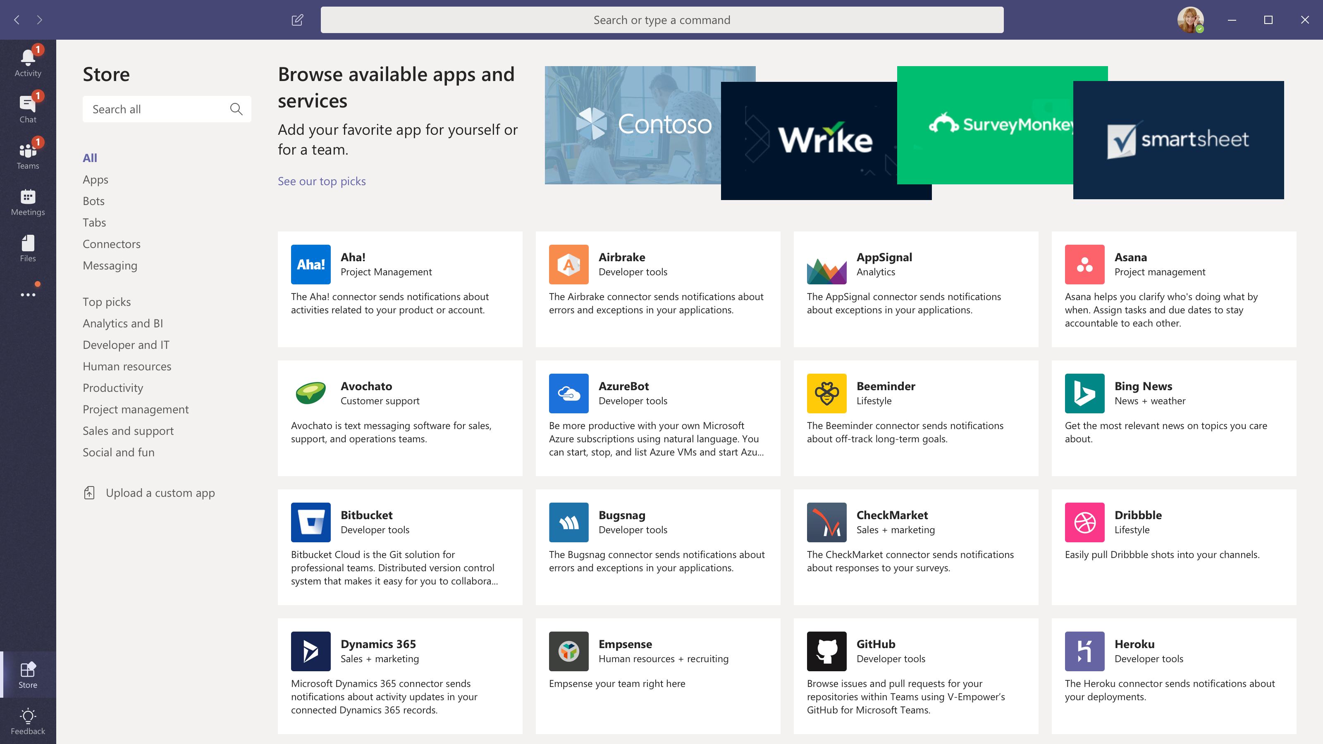
Dynamics 365 - Talent

Slide 10
Tabs

Slide 11
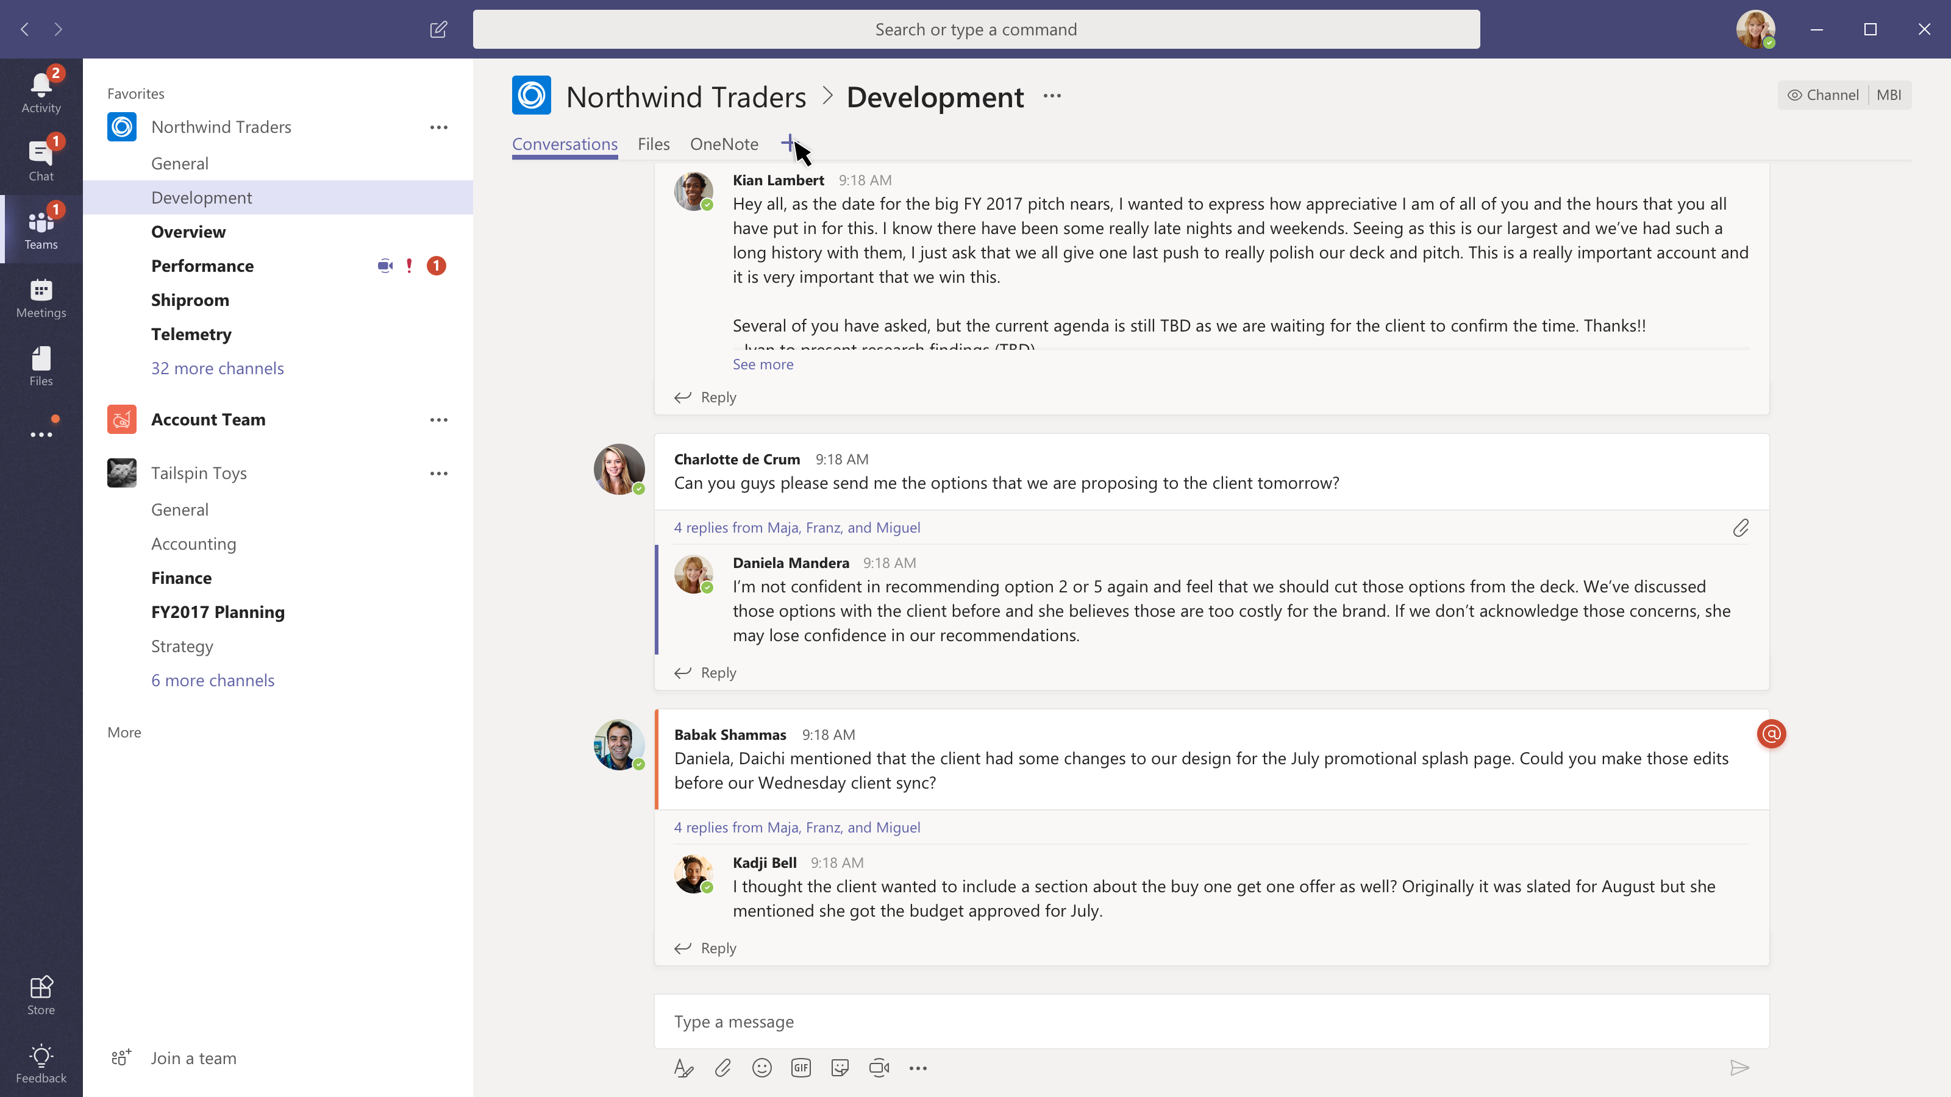

Slide 12
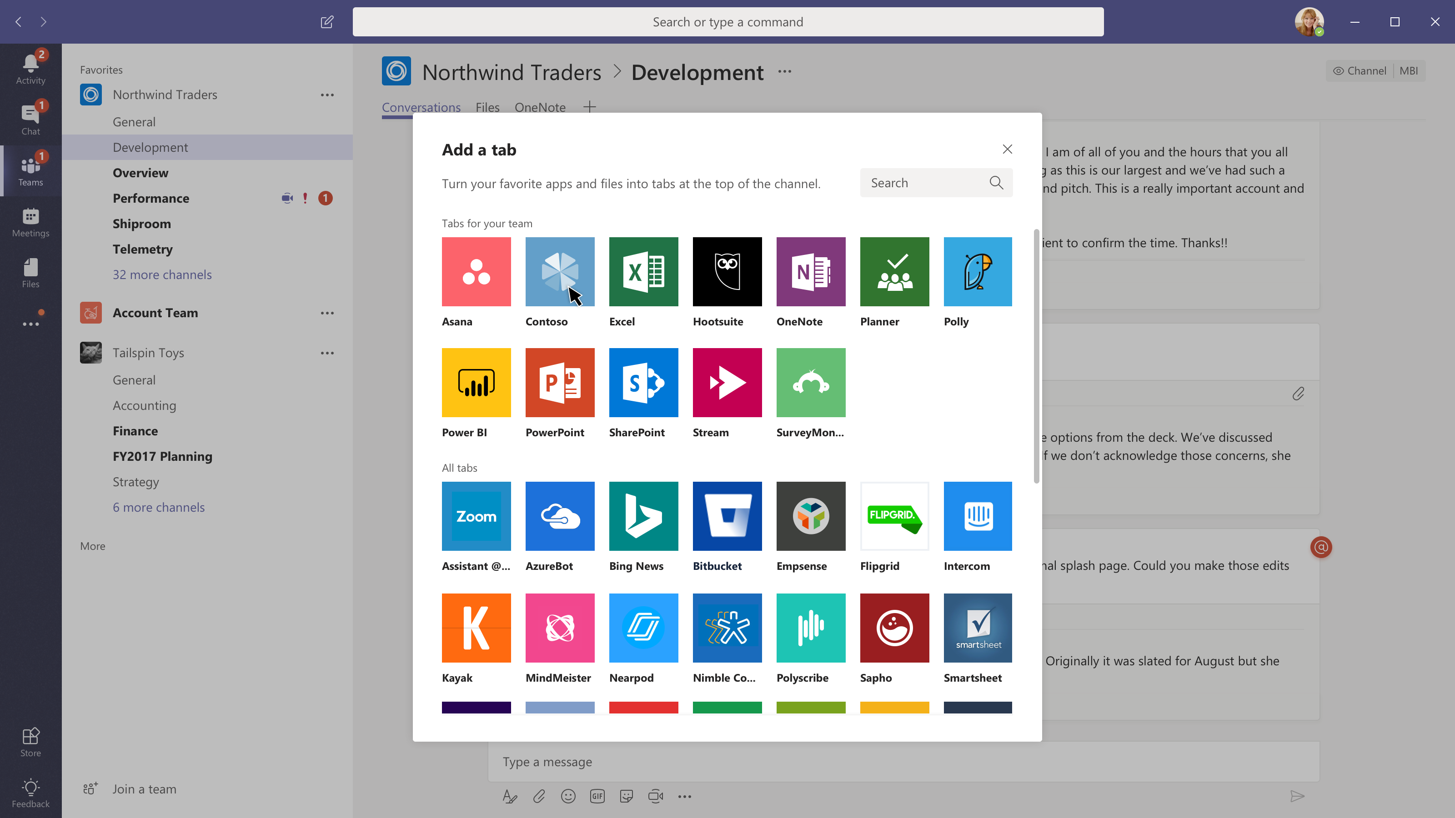

Slide 13
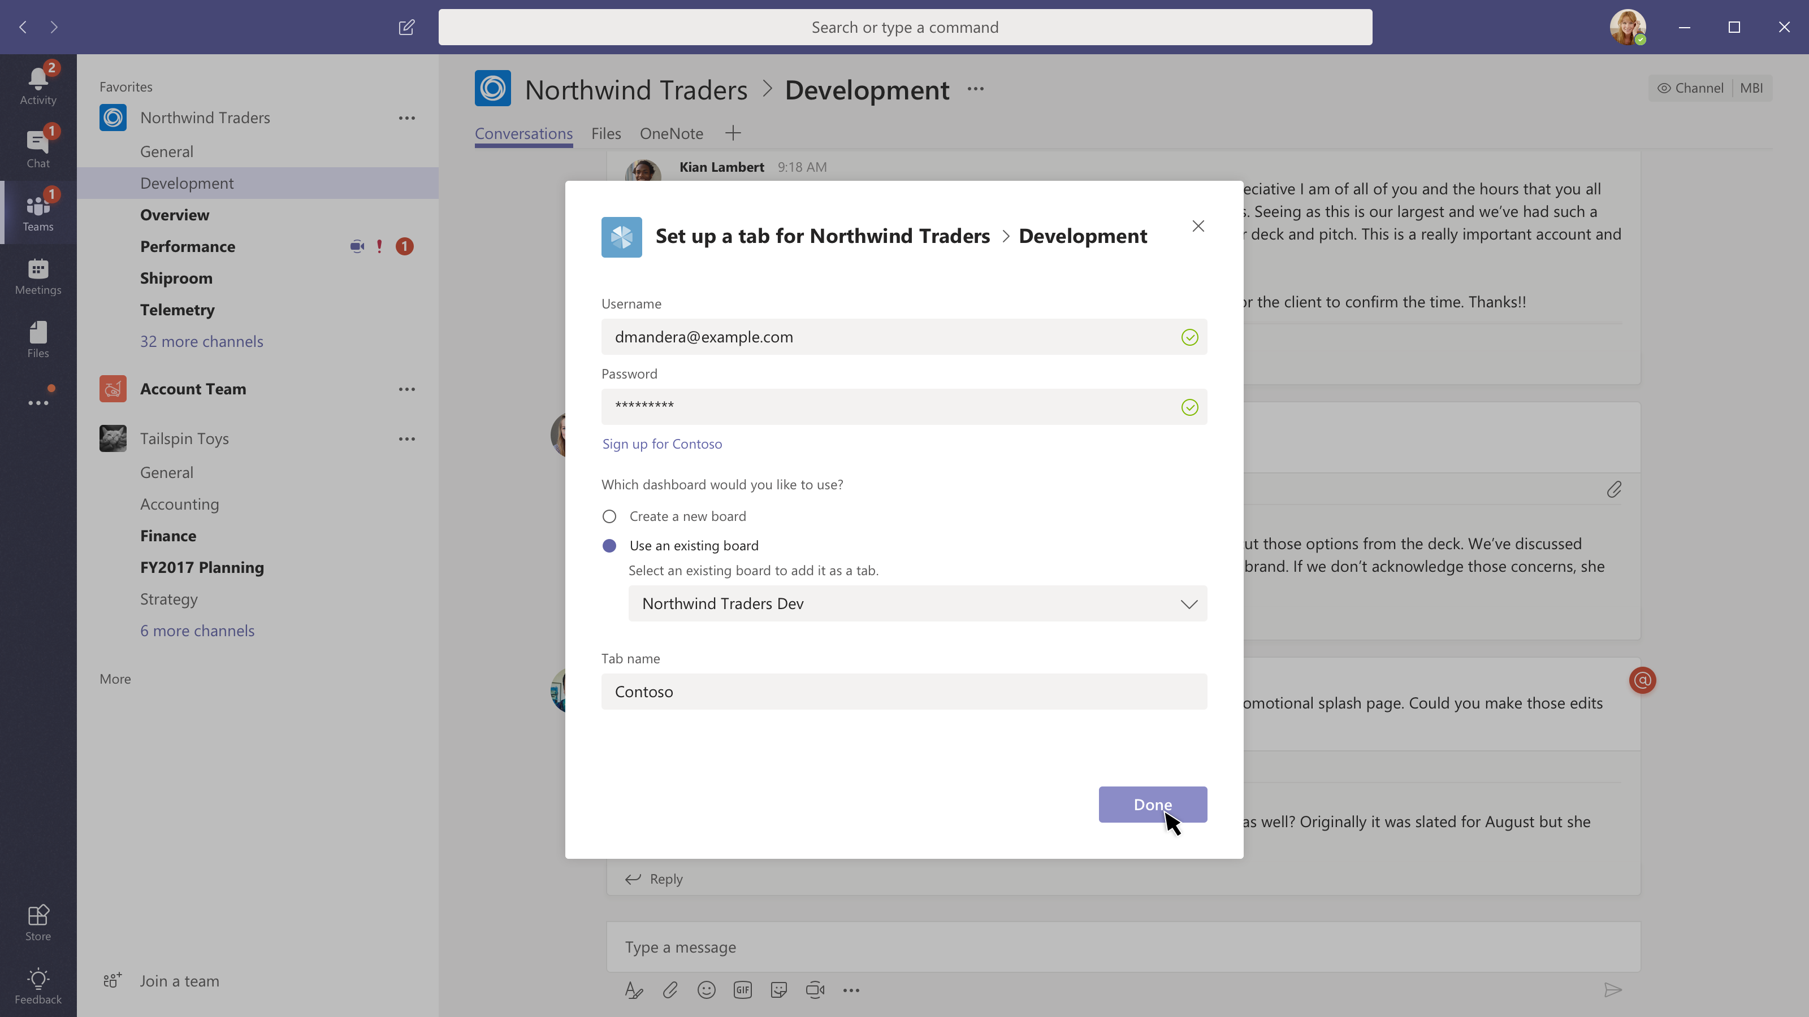

Slide 14
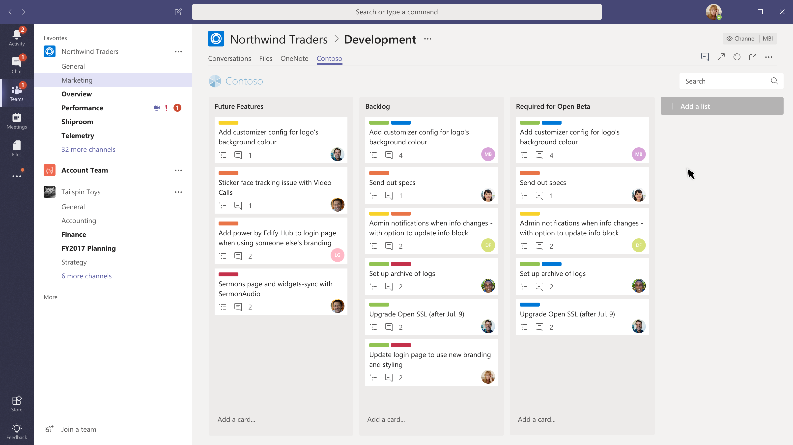

Slide 15
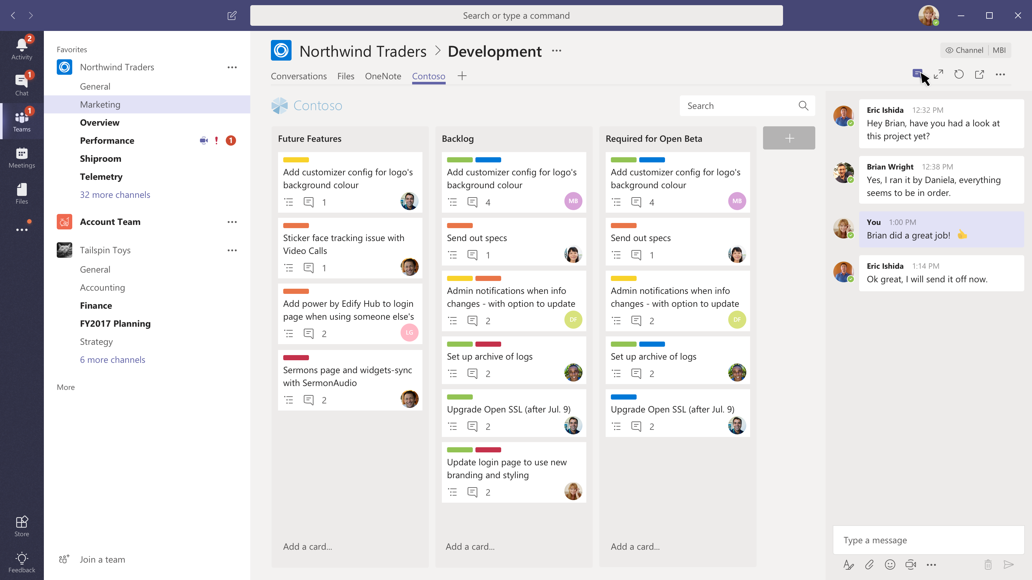

Slide 16
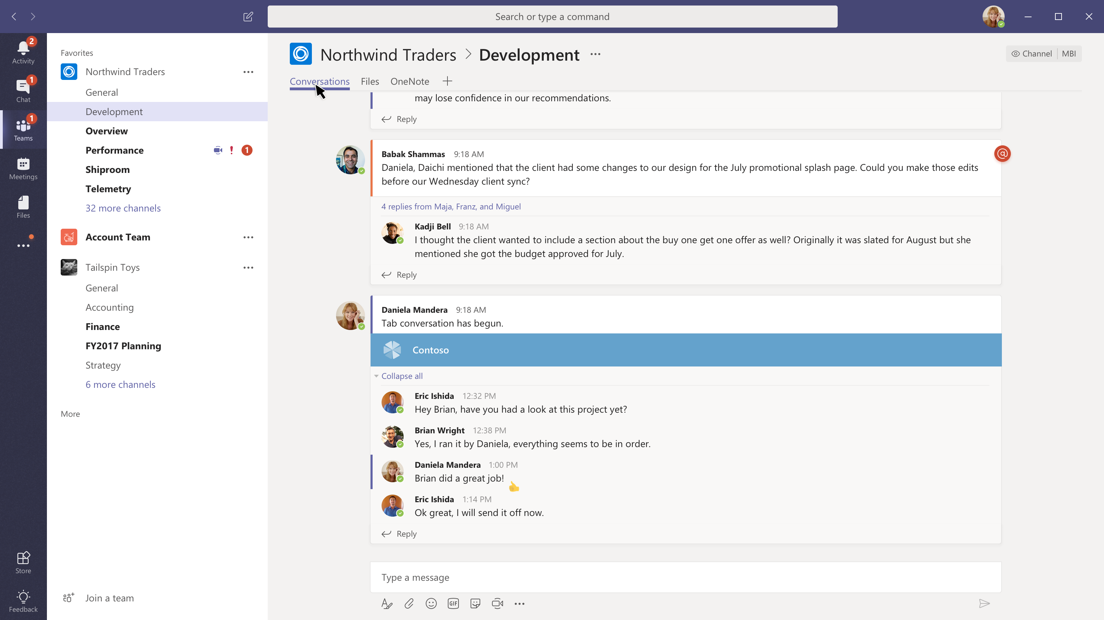

Slide 17
Bots

Slide 18
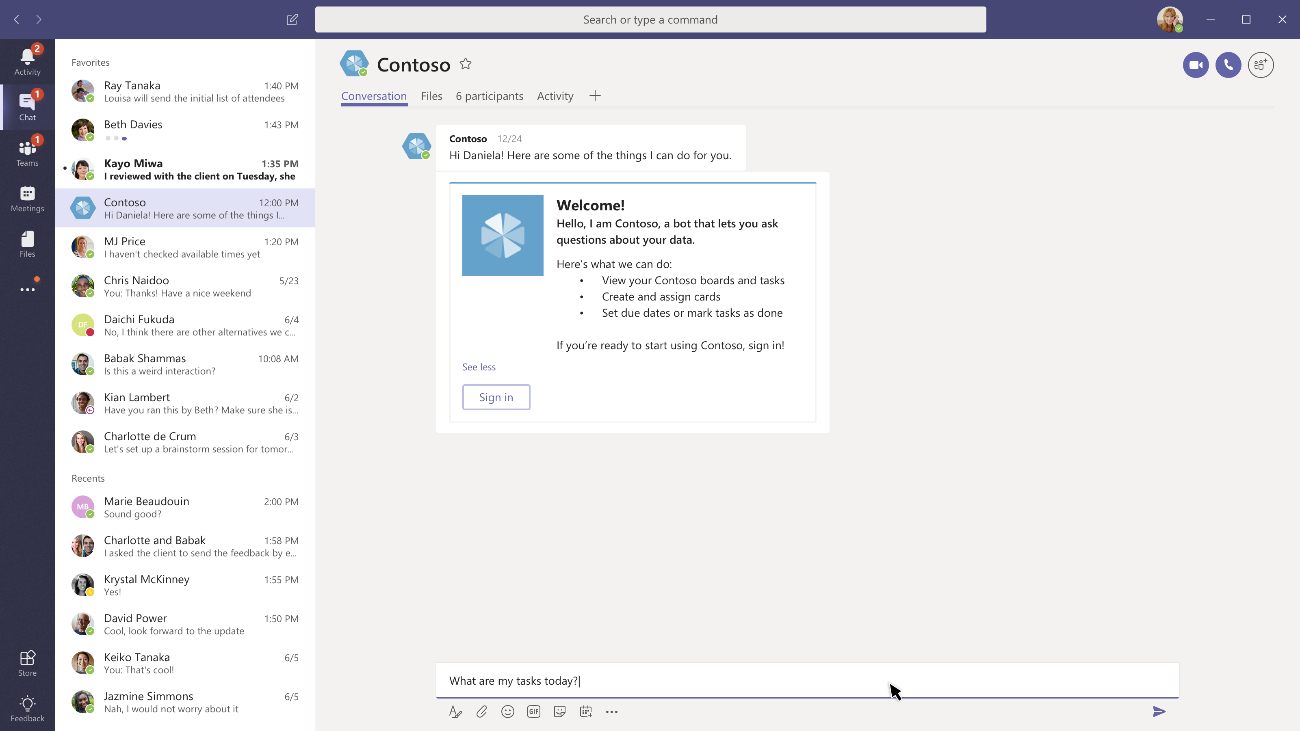

Slide 19
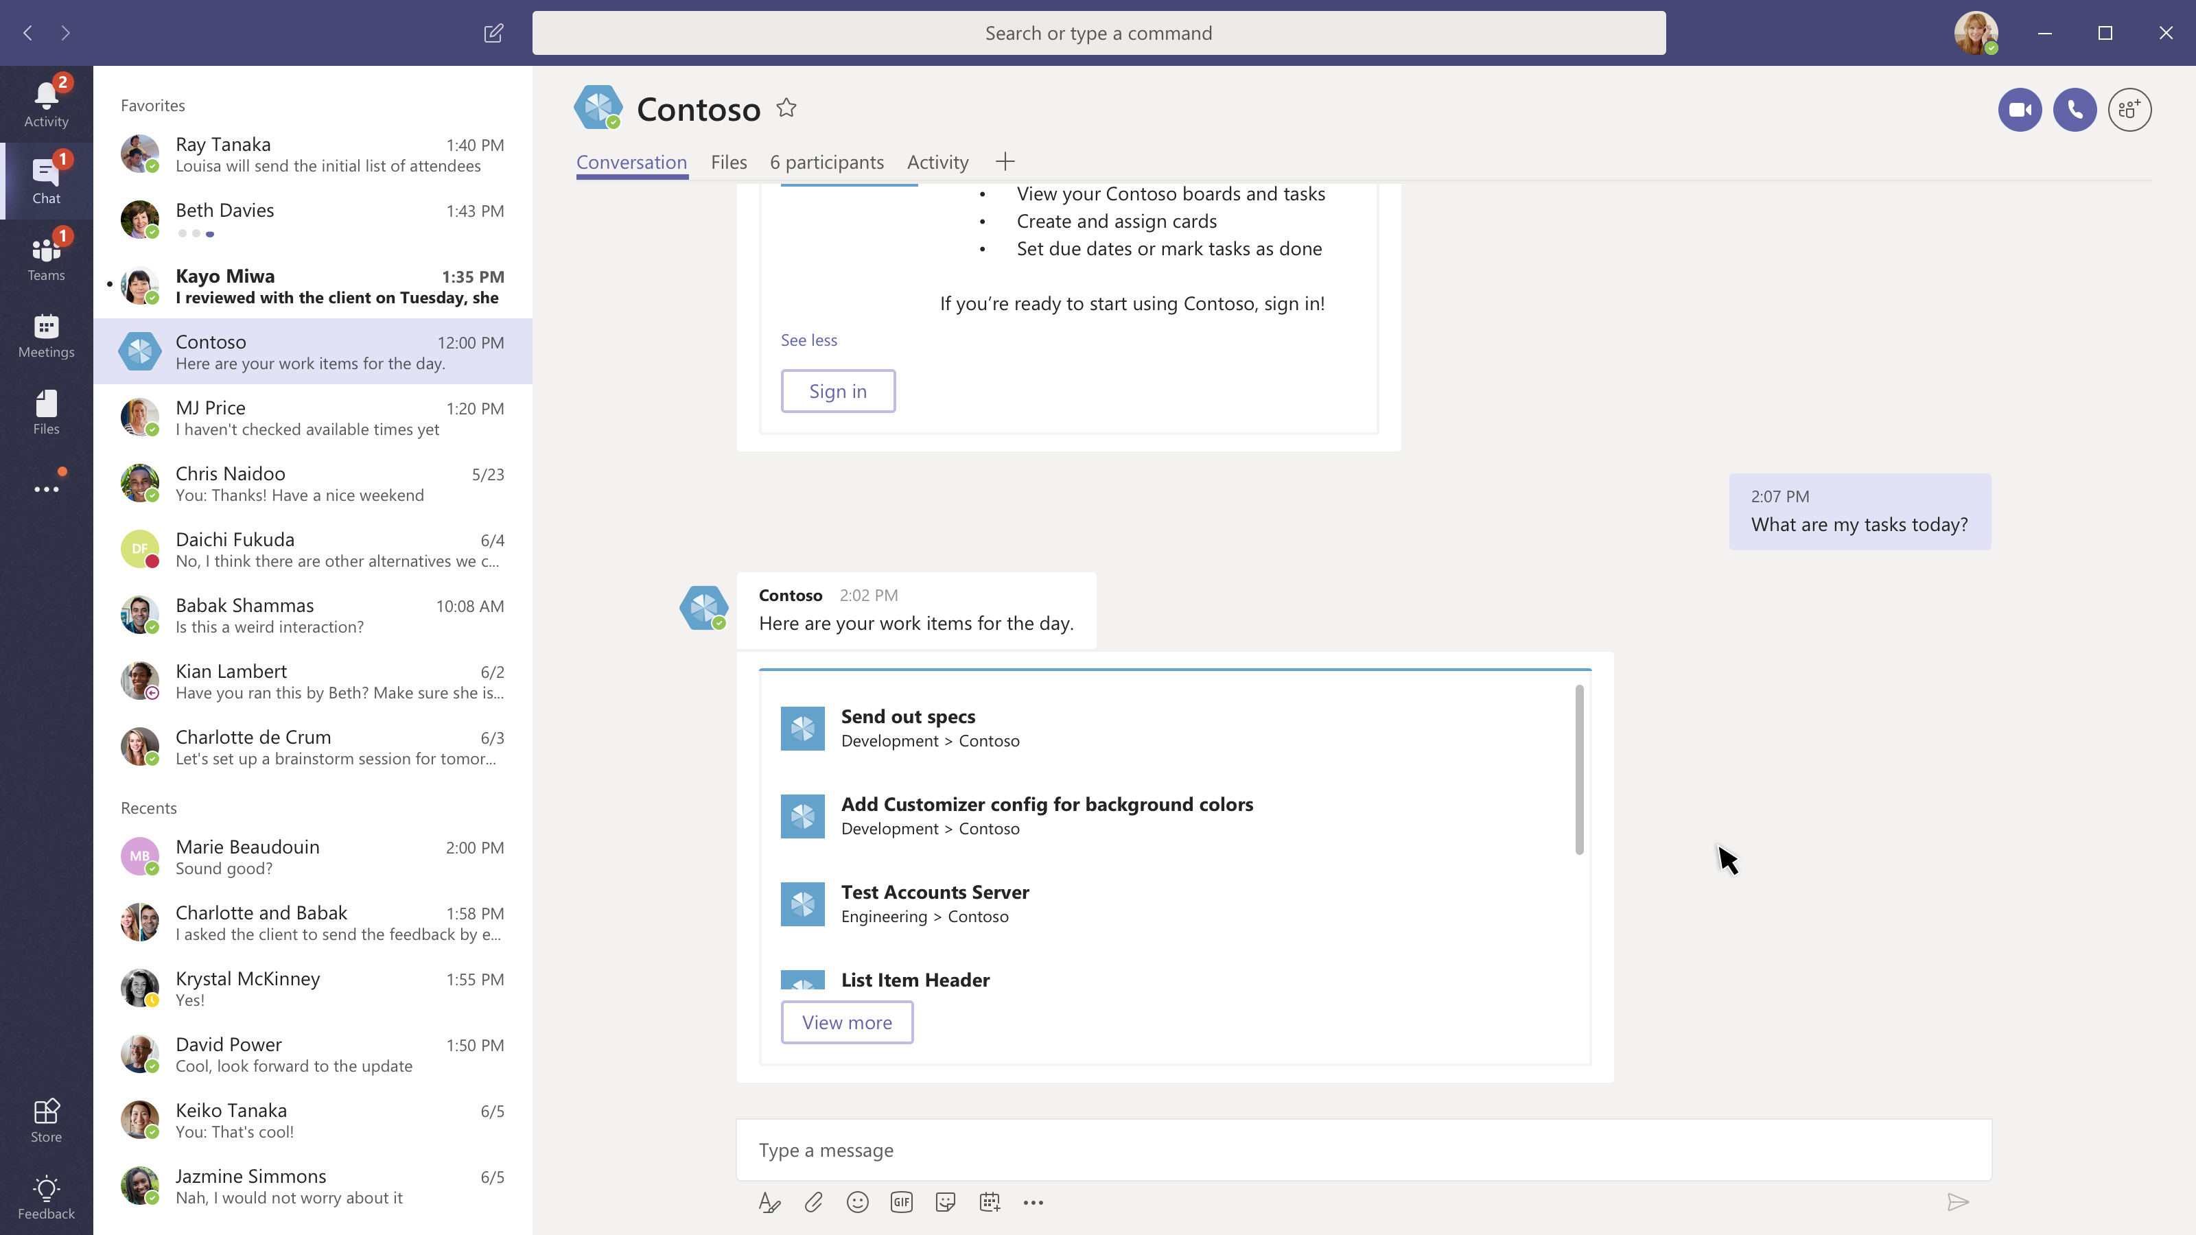

Slide 20
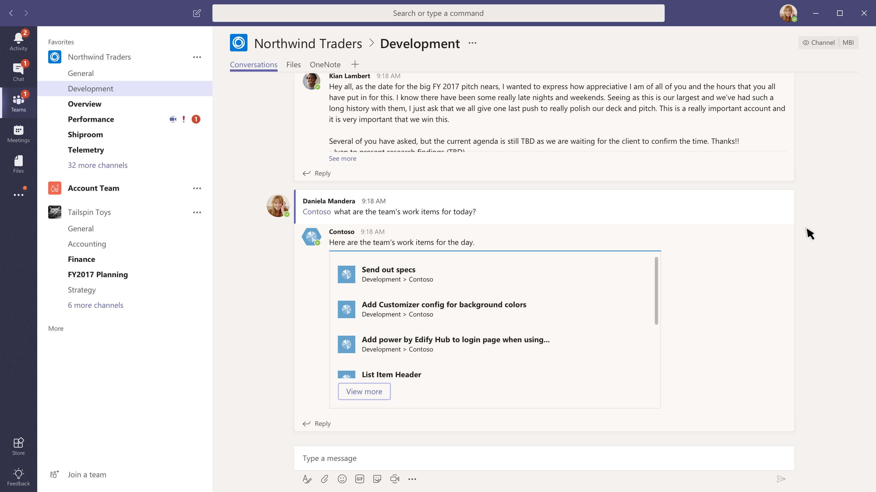
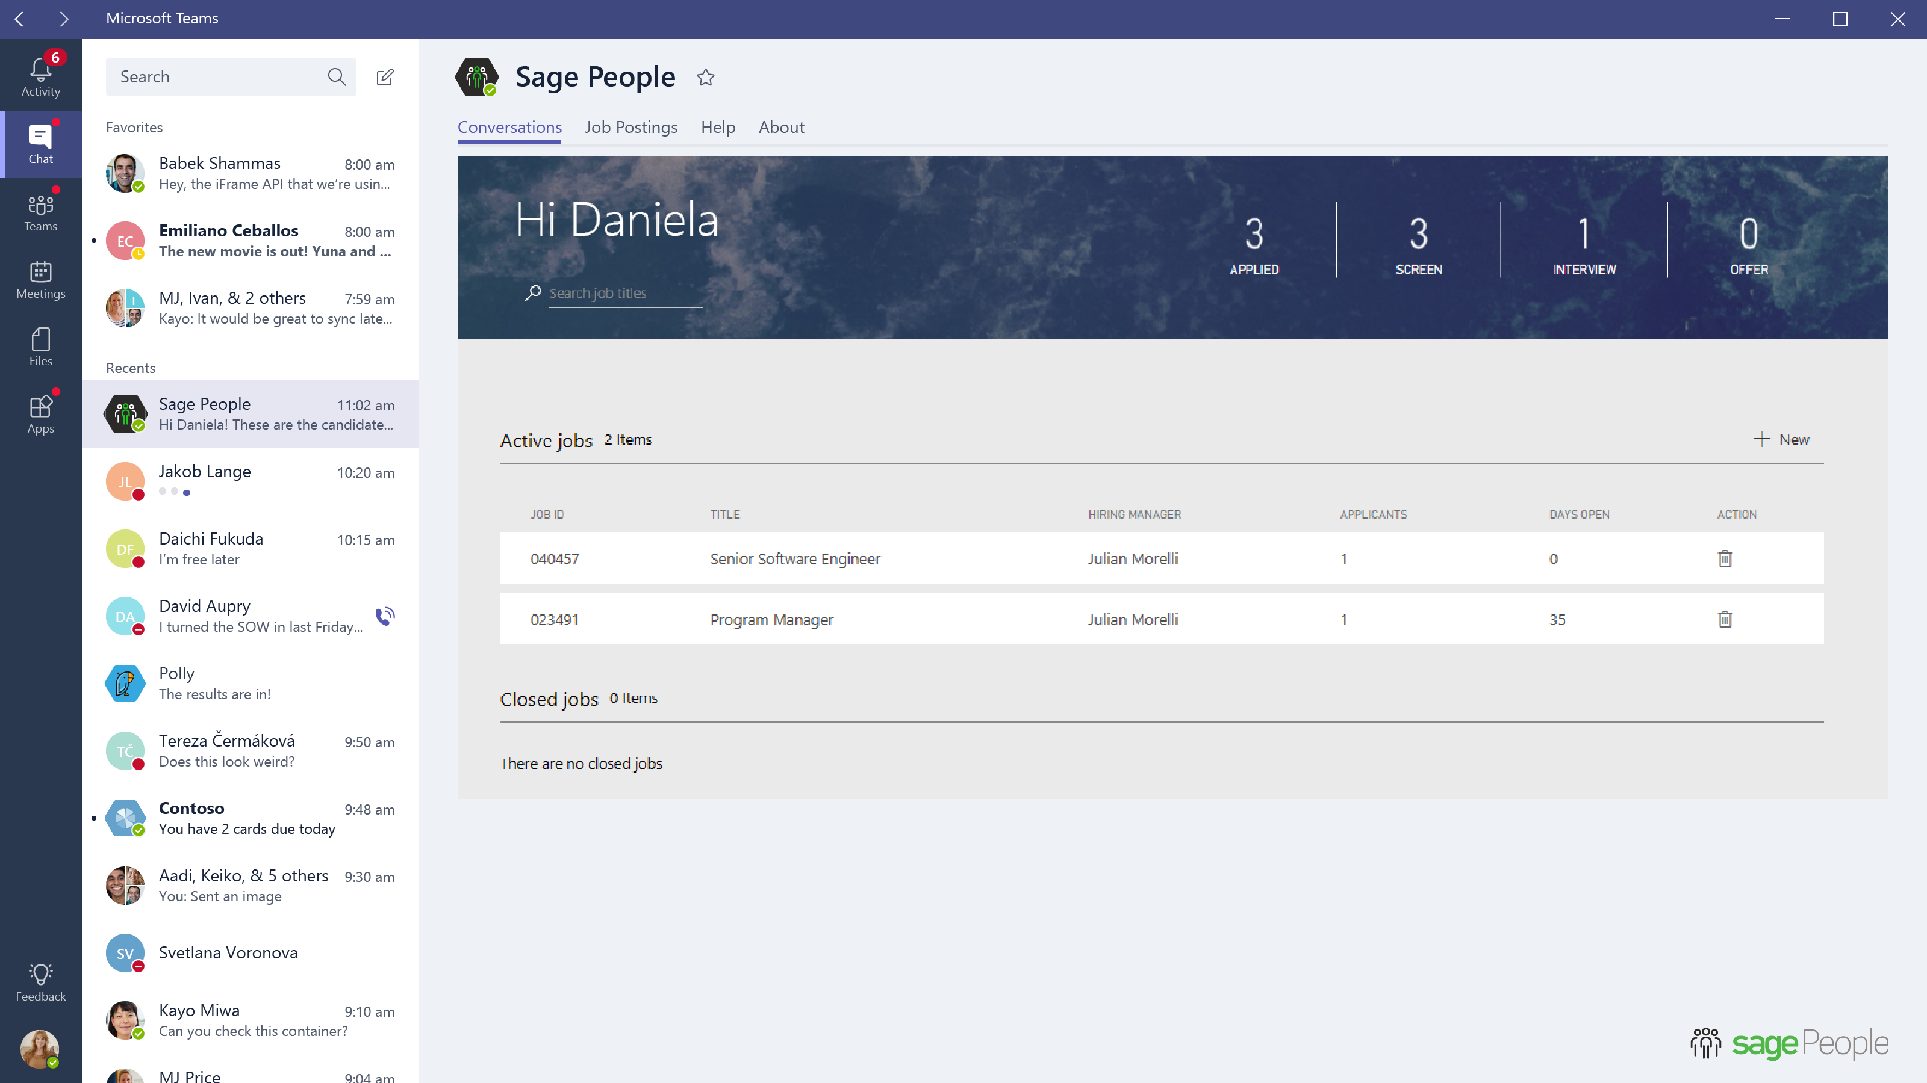
Talent Bot
Job Postings
Talent
Talent
list all active positions..

Slide 21
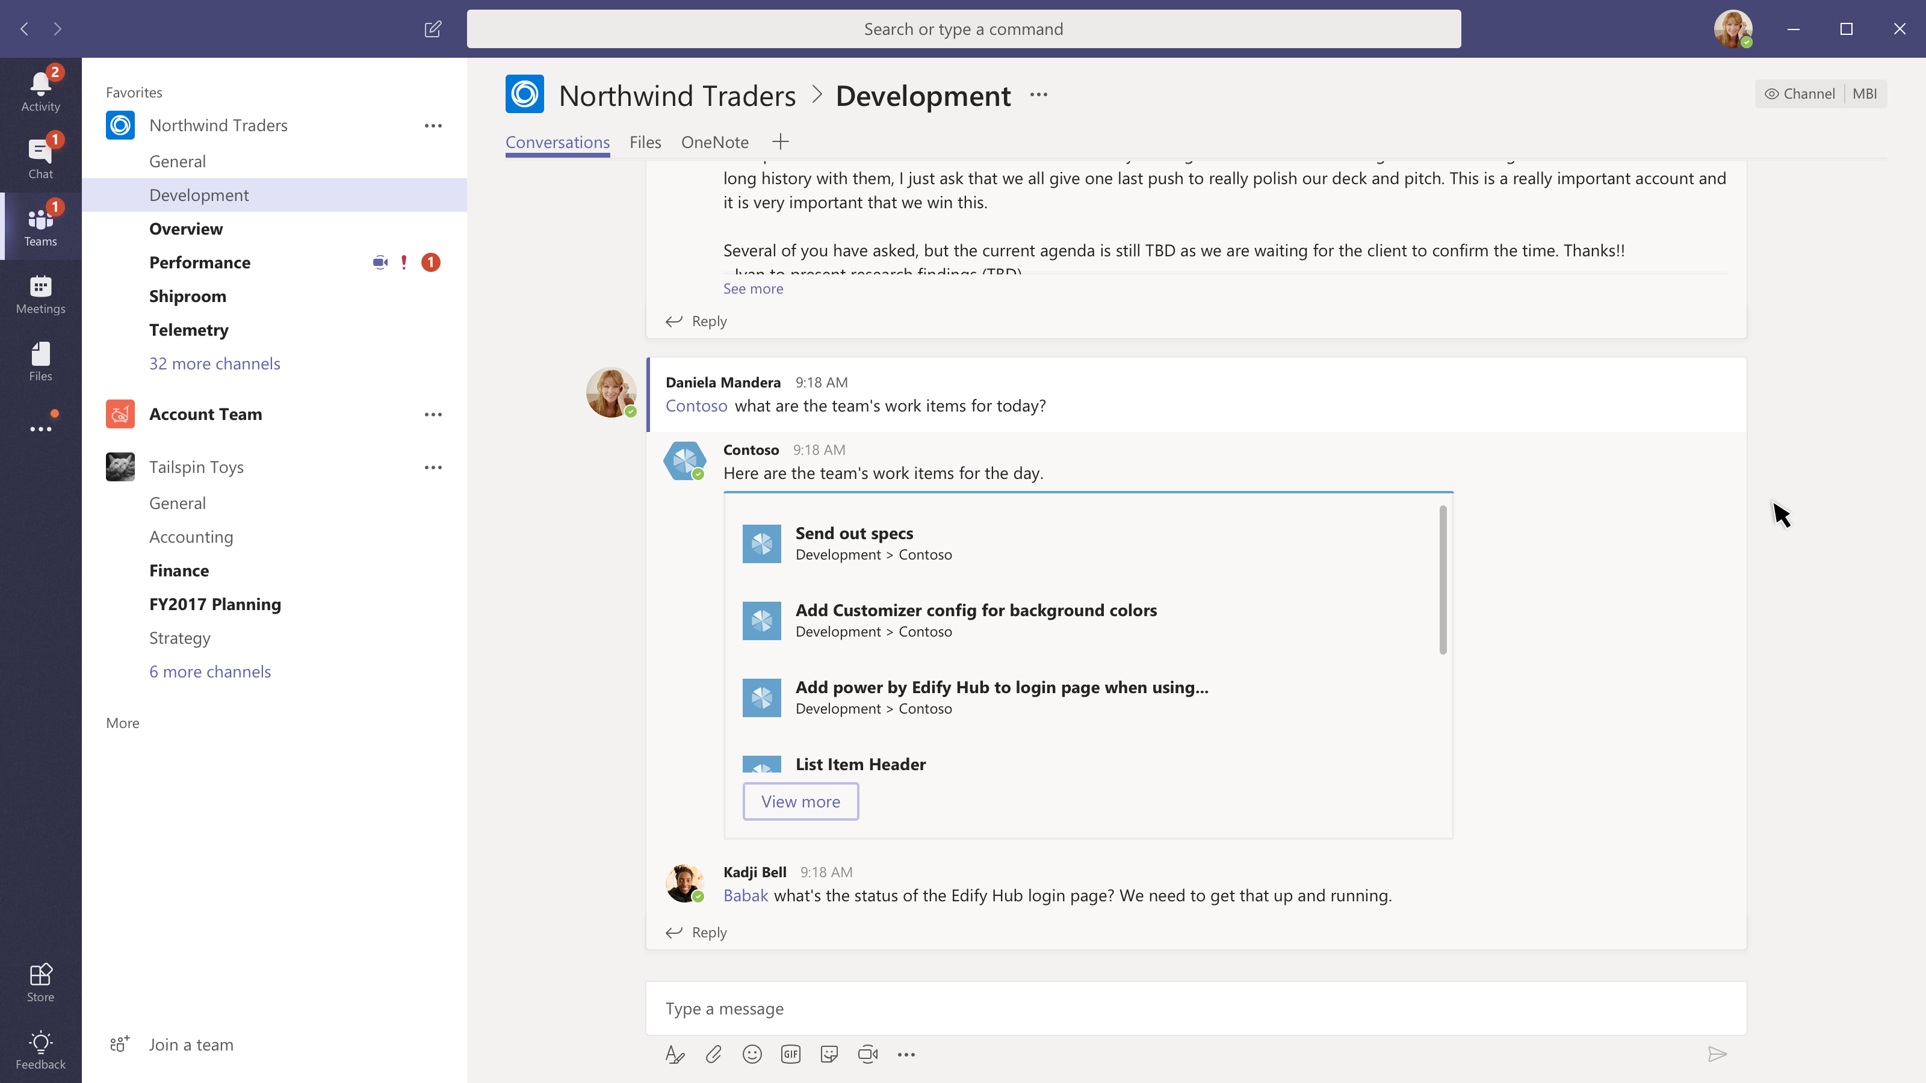

Slide 22
Messaging extensions

Slide 23
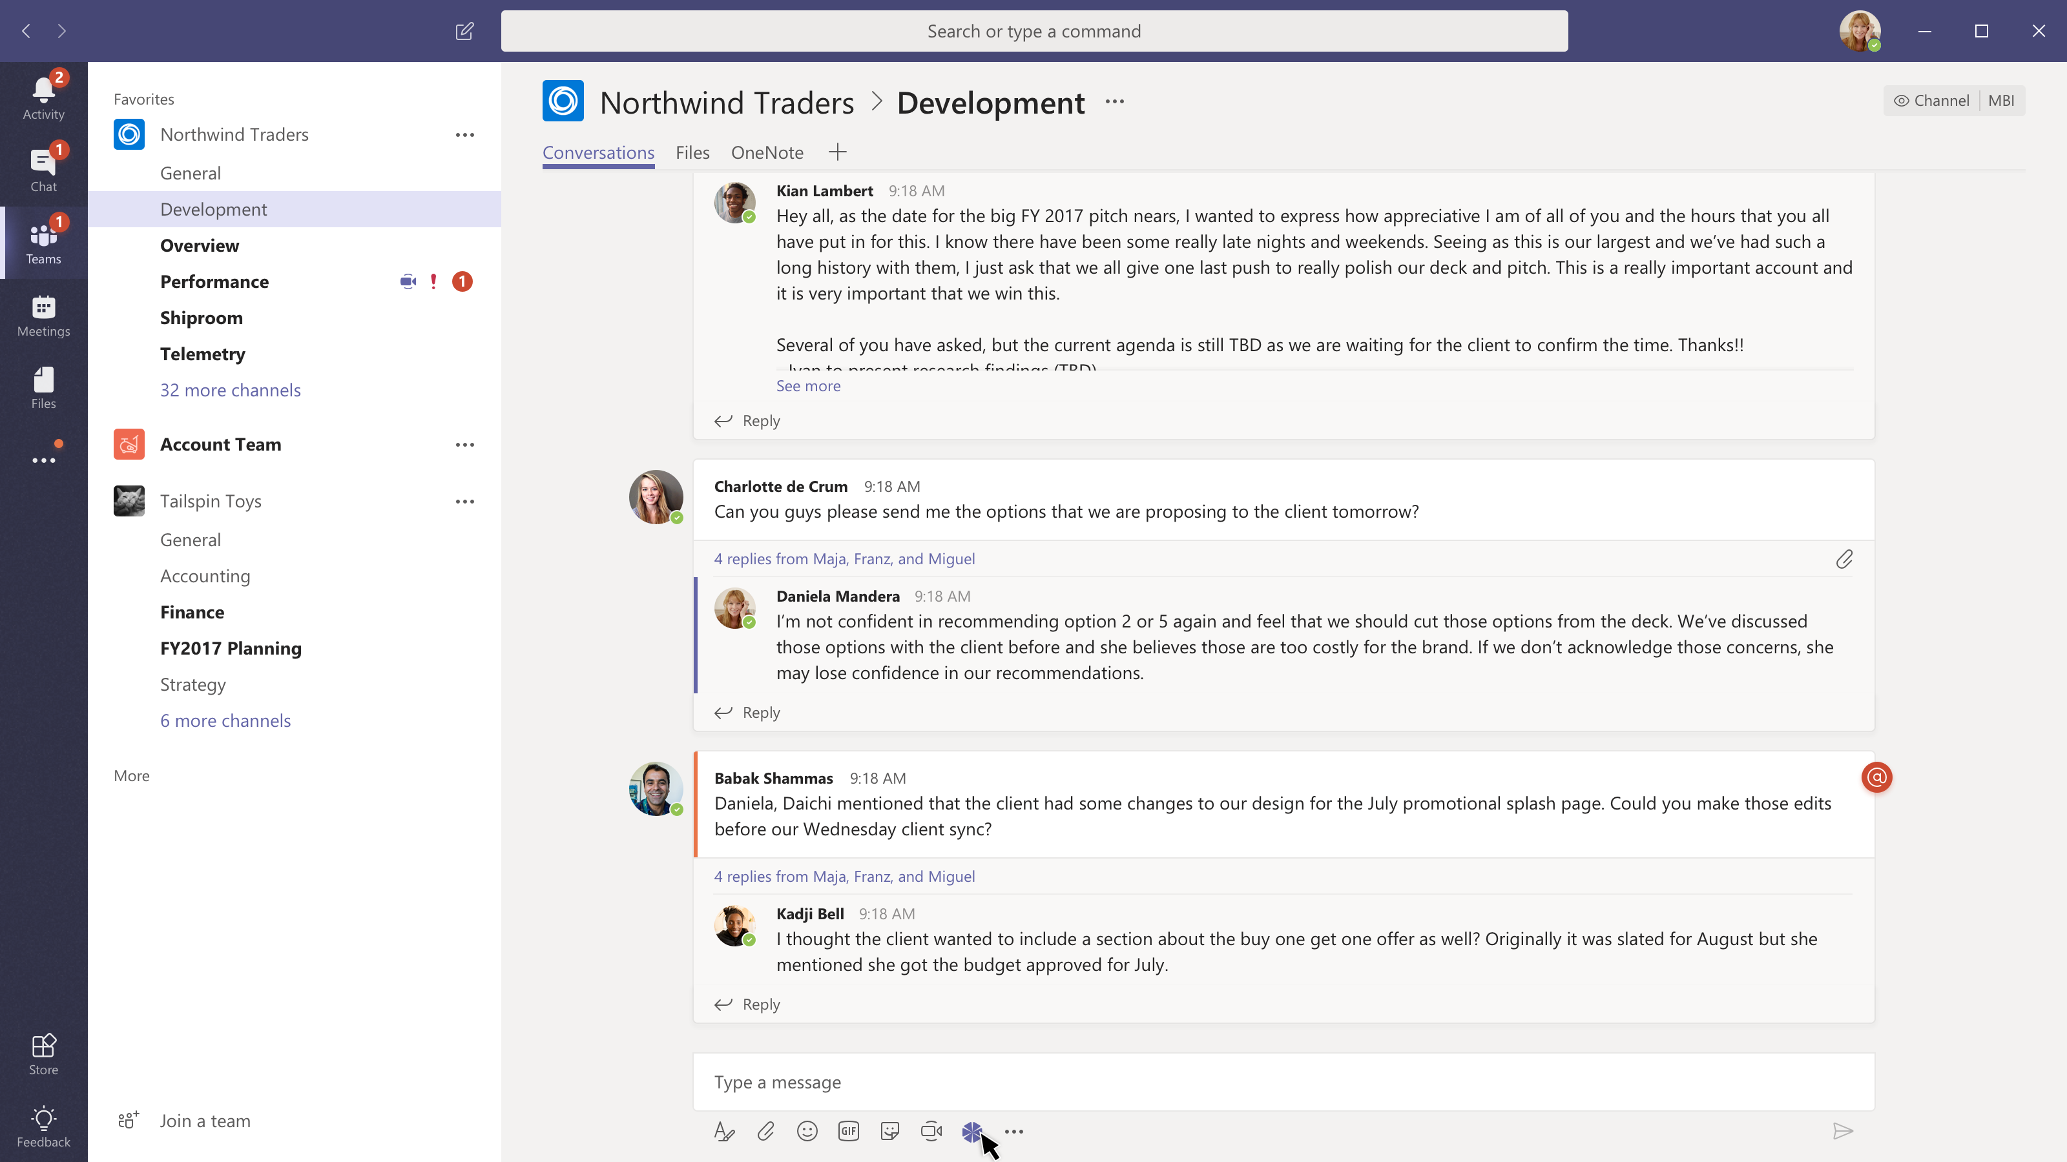

Slide 24
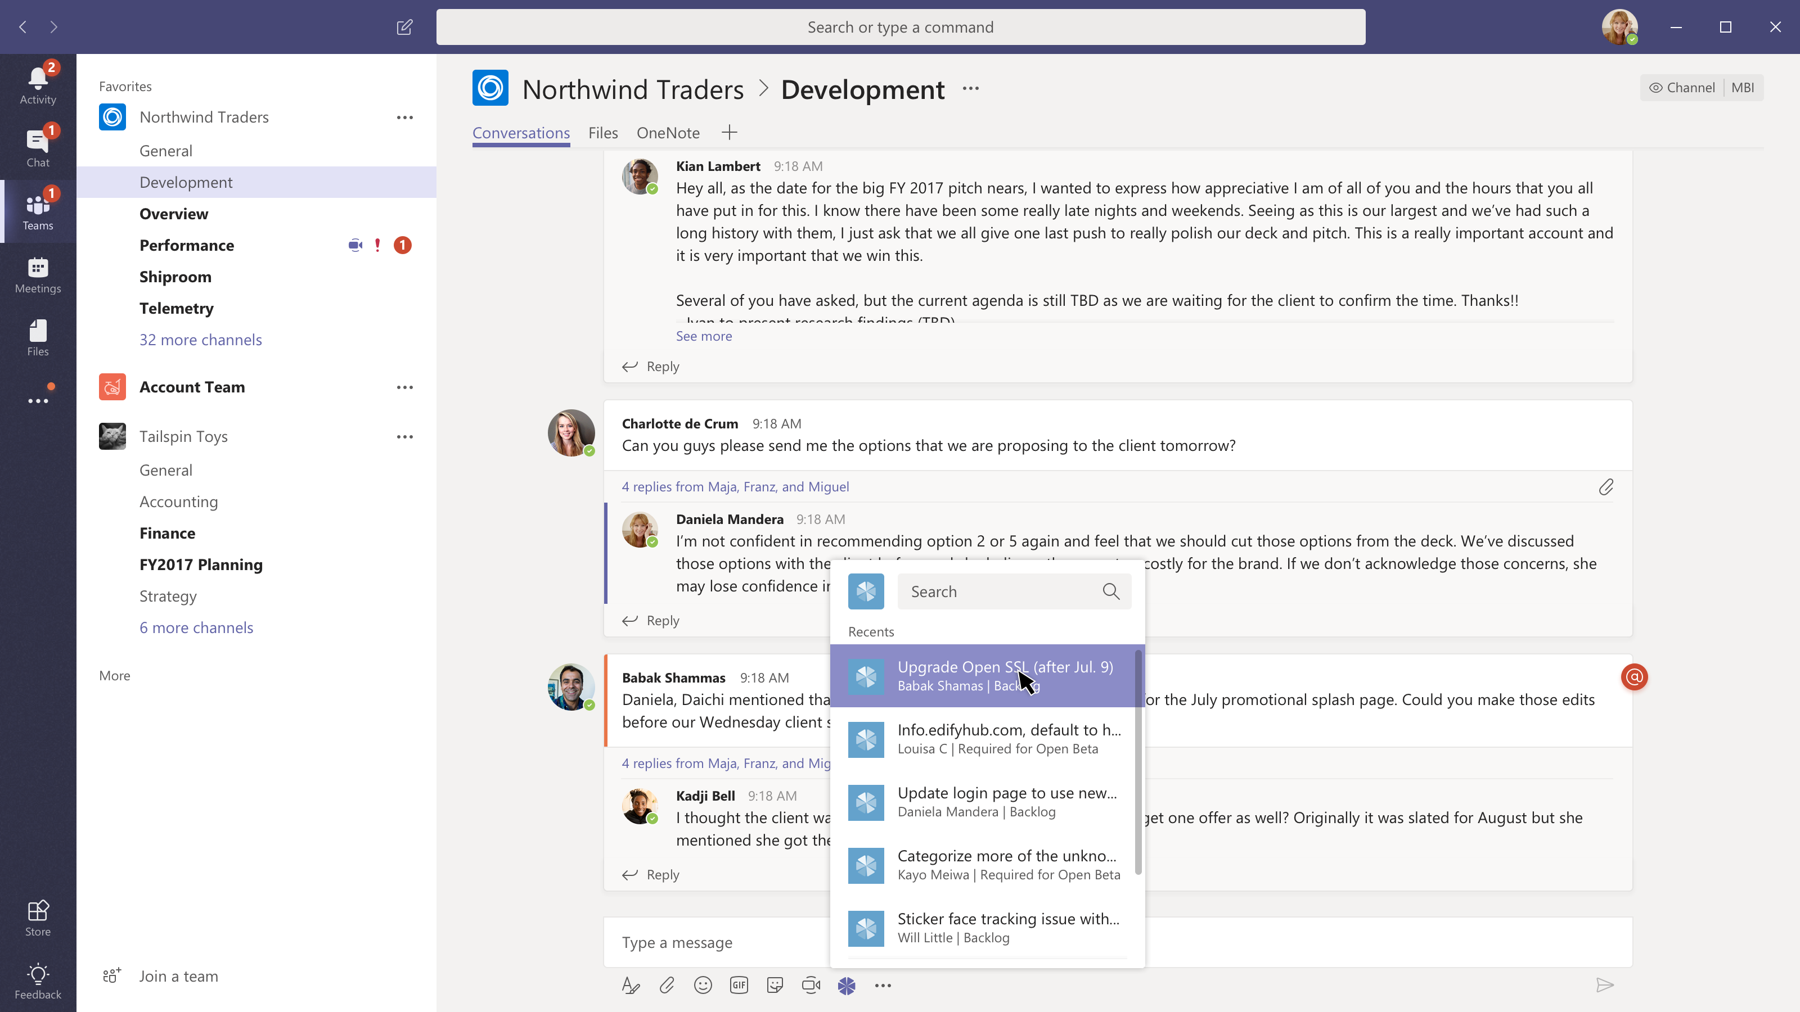

Slide 25
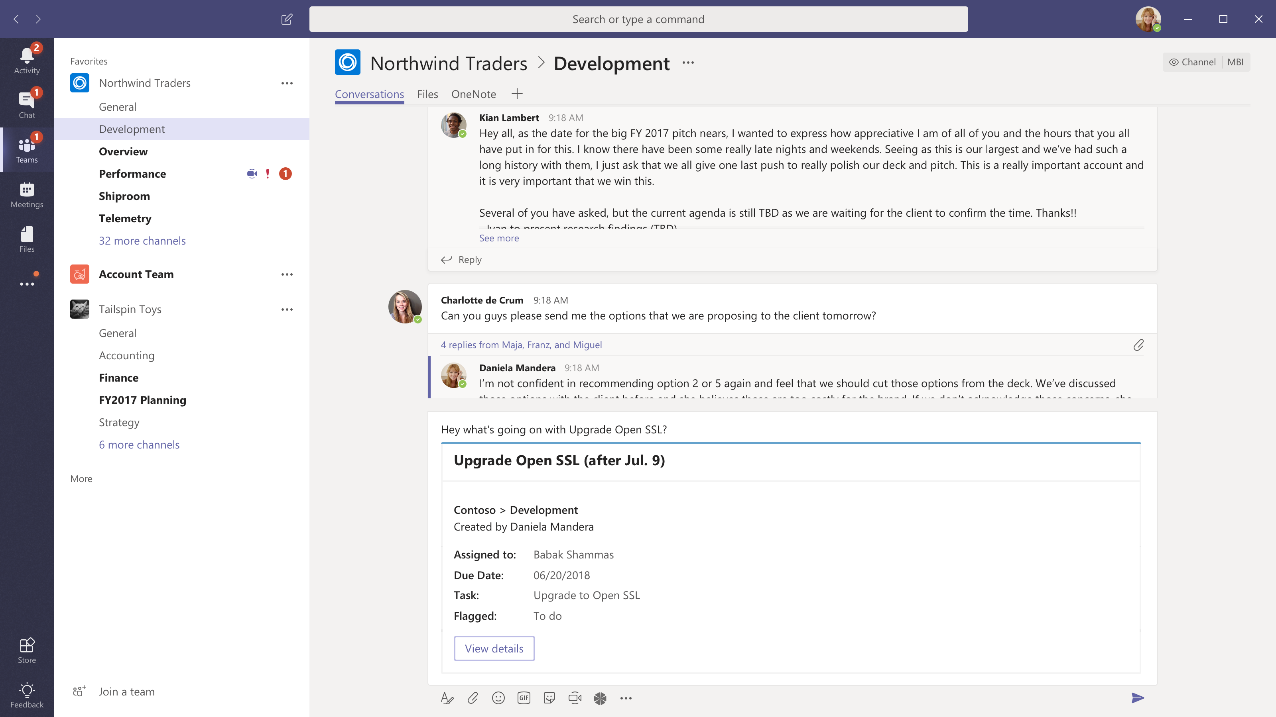

Slide 26
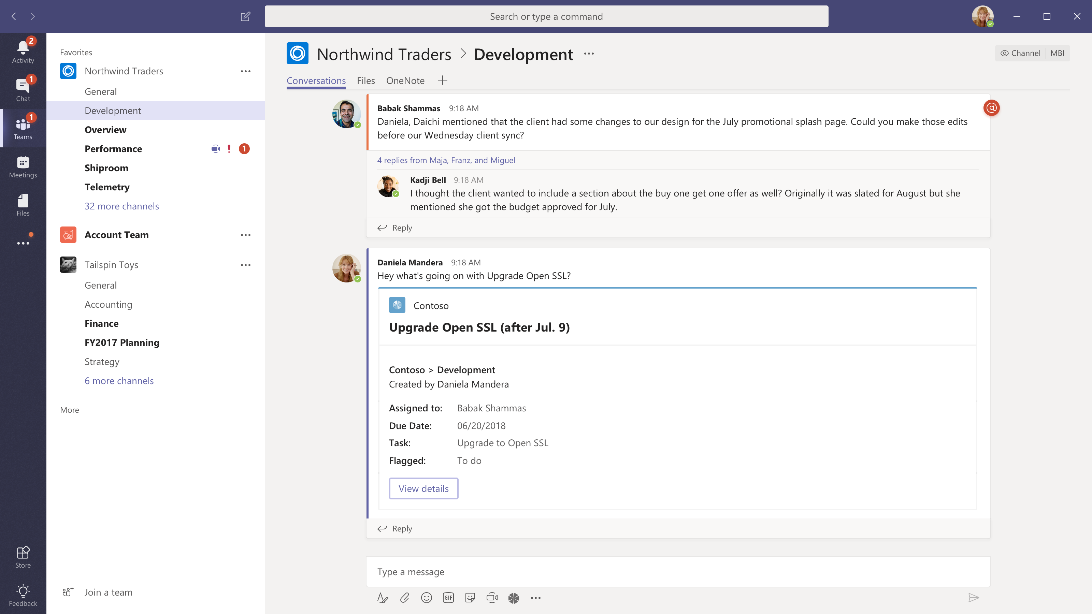

Slide 27
Activity Feed

Slide 28
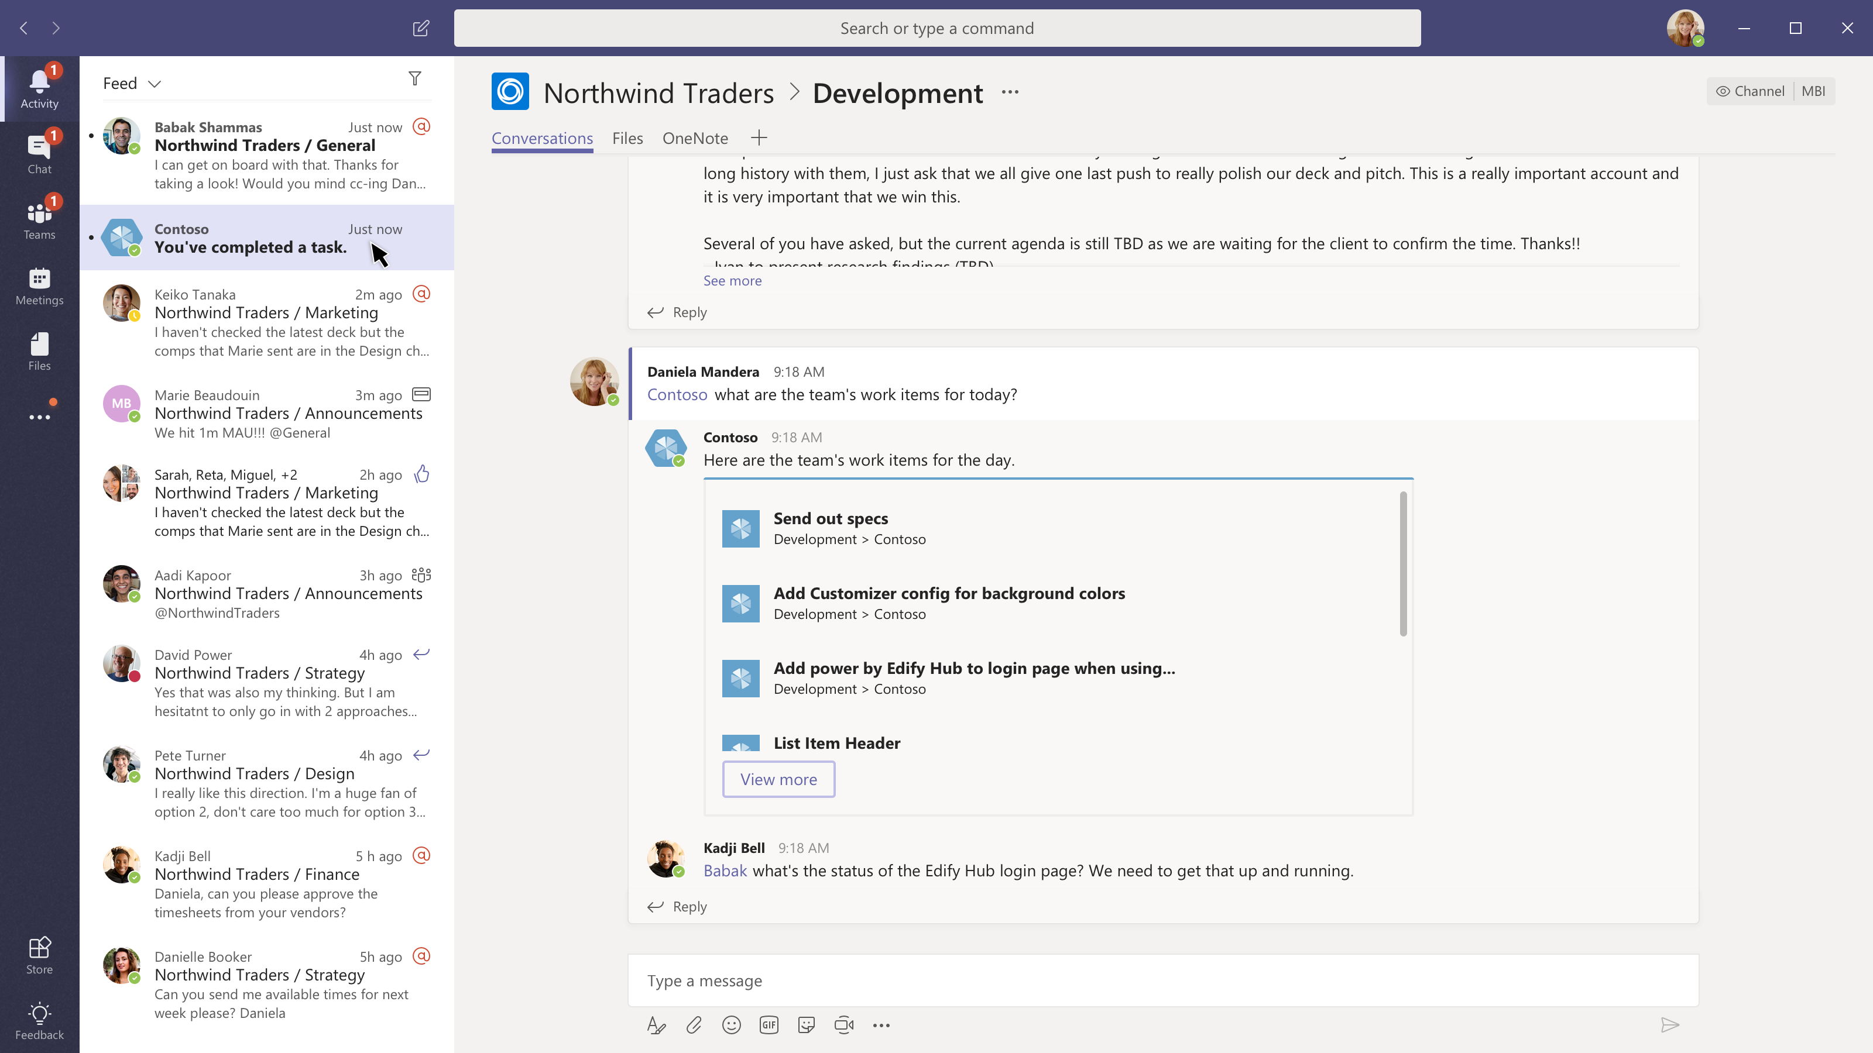

Slide 29
Connectors

Slide 30
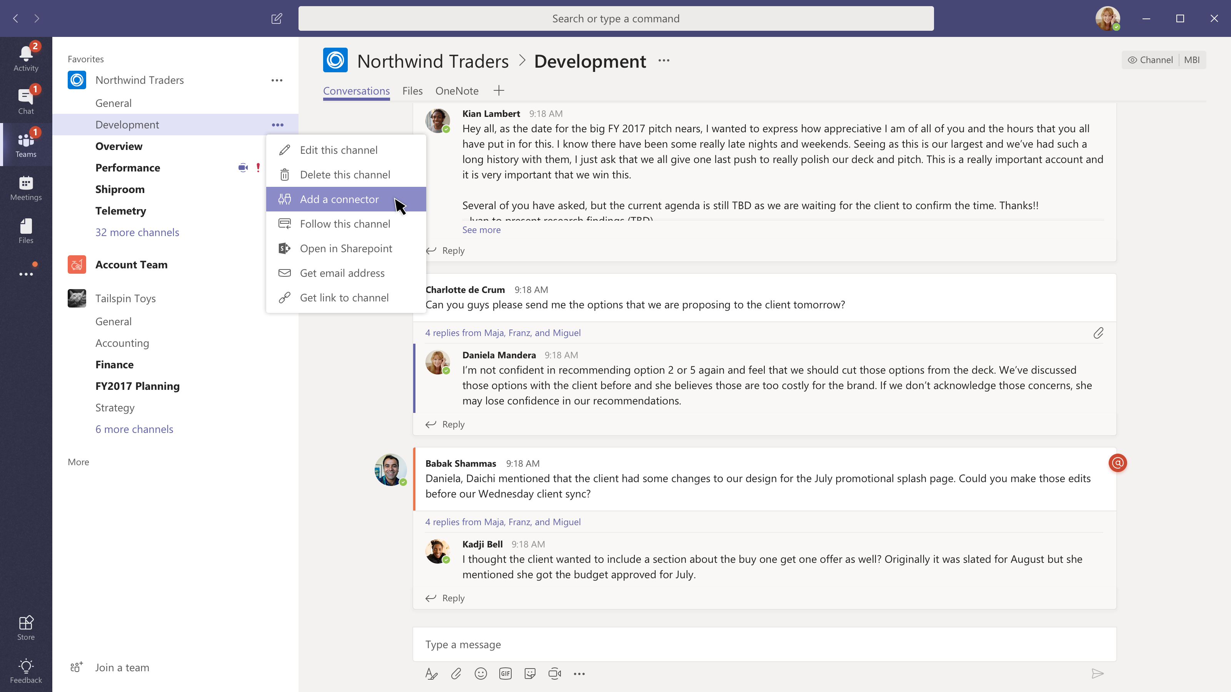

Slide 31
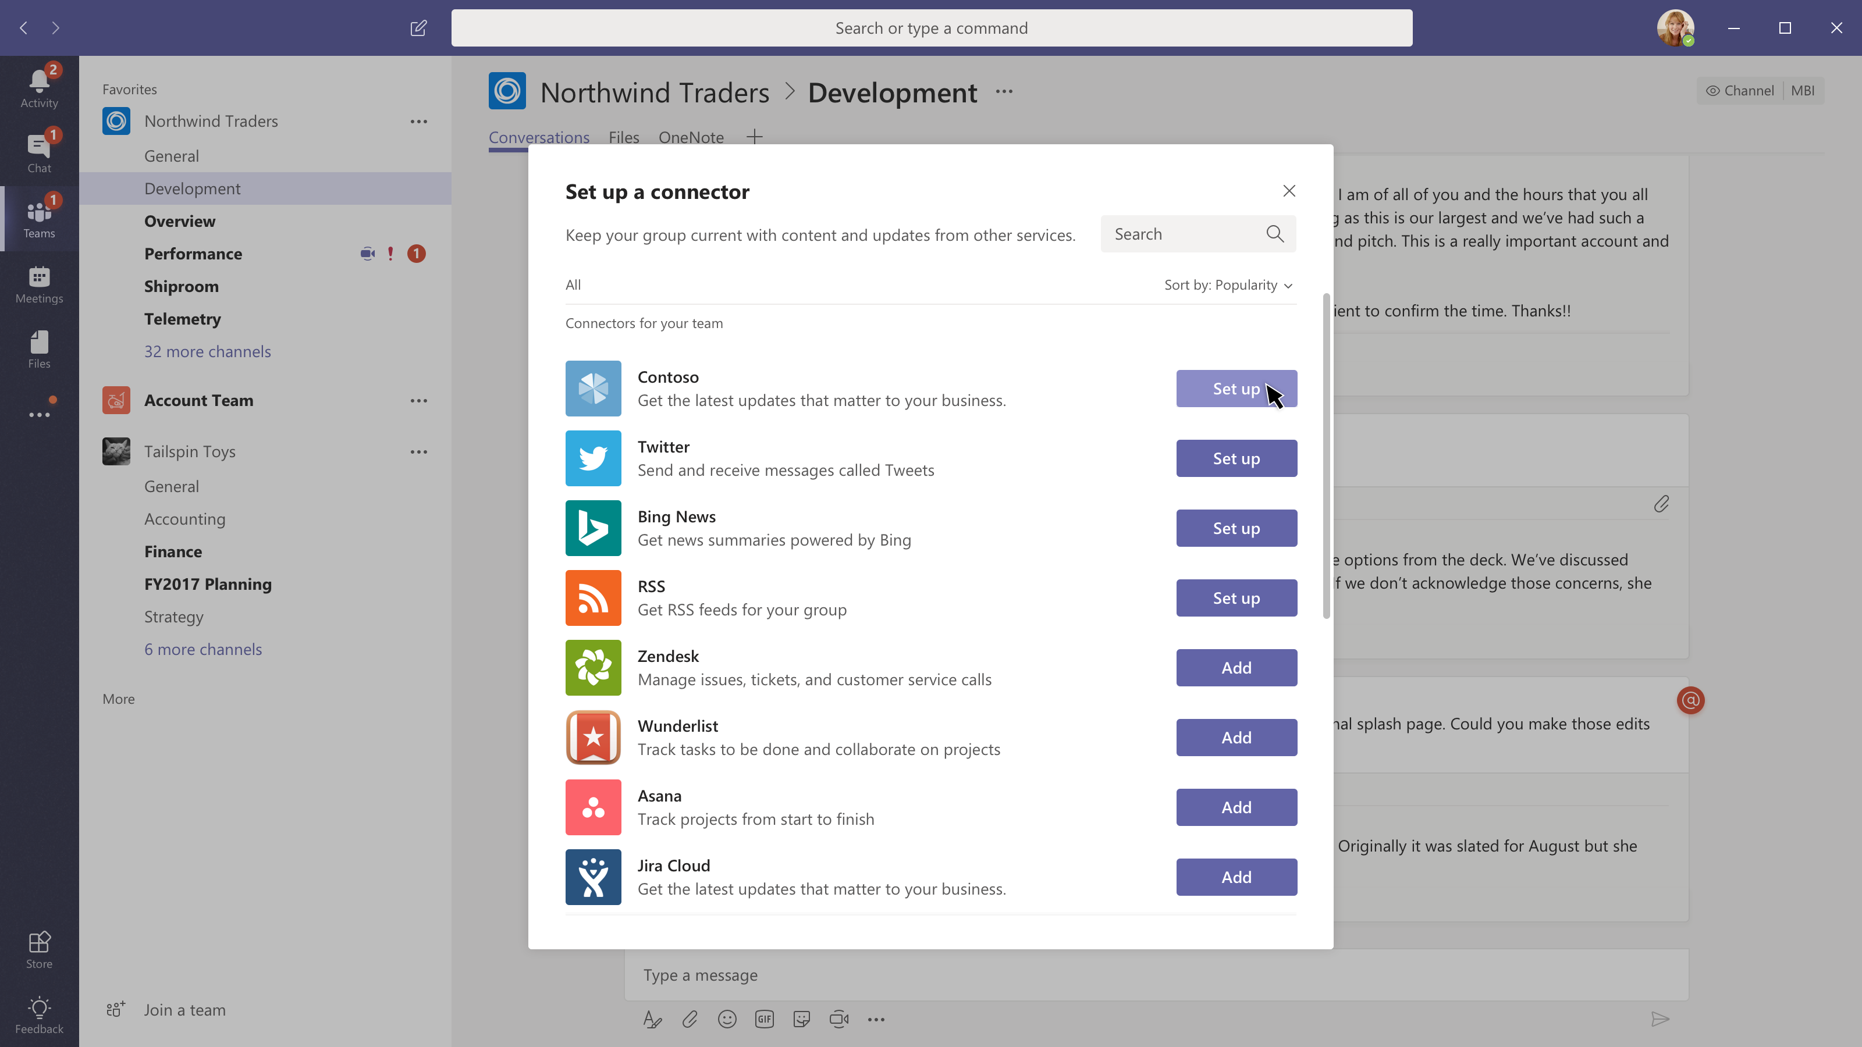

Slide 32
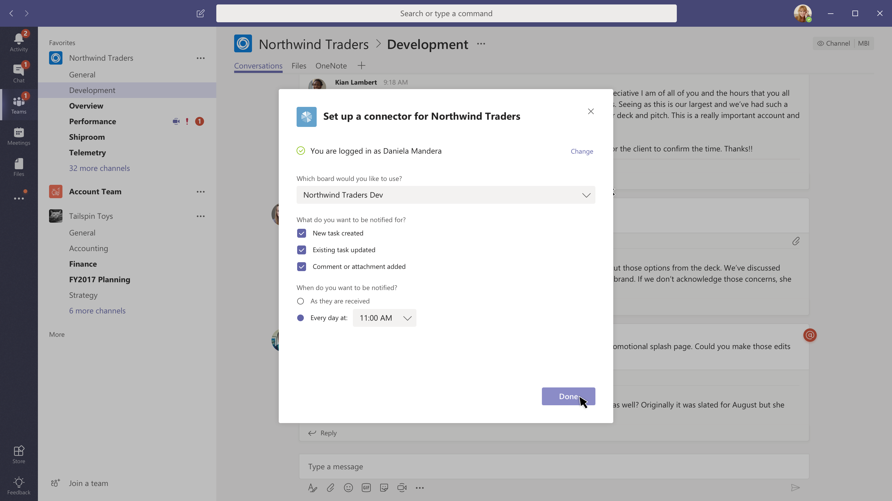

Slide 33
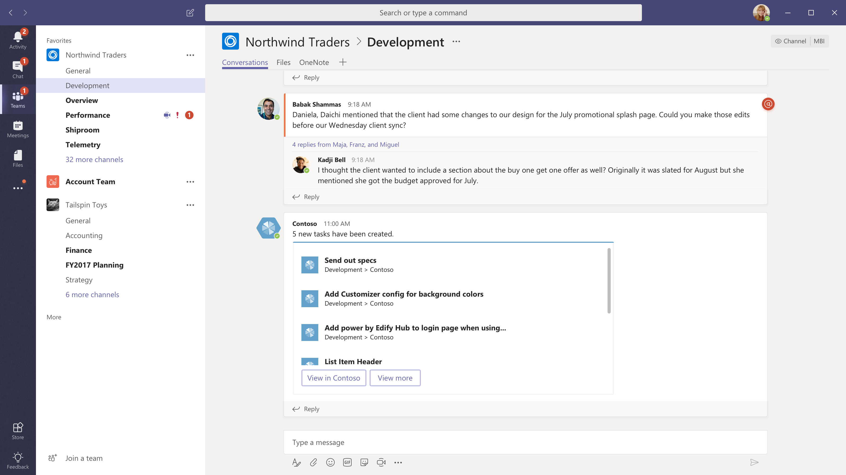

Slide 34
Command box

Slide 35
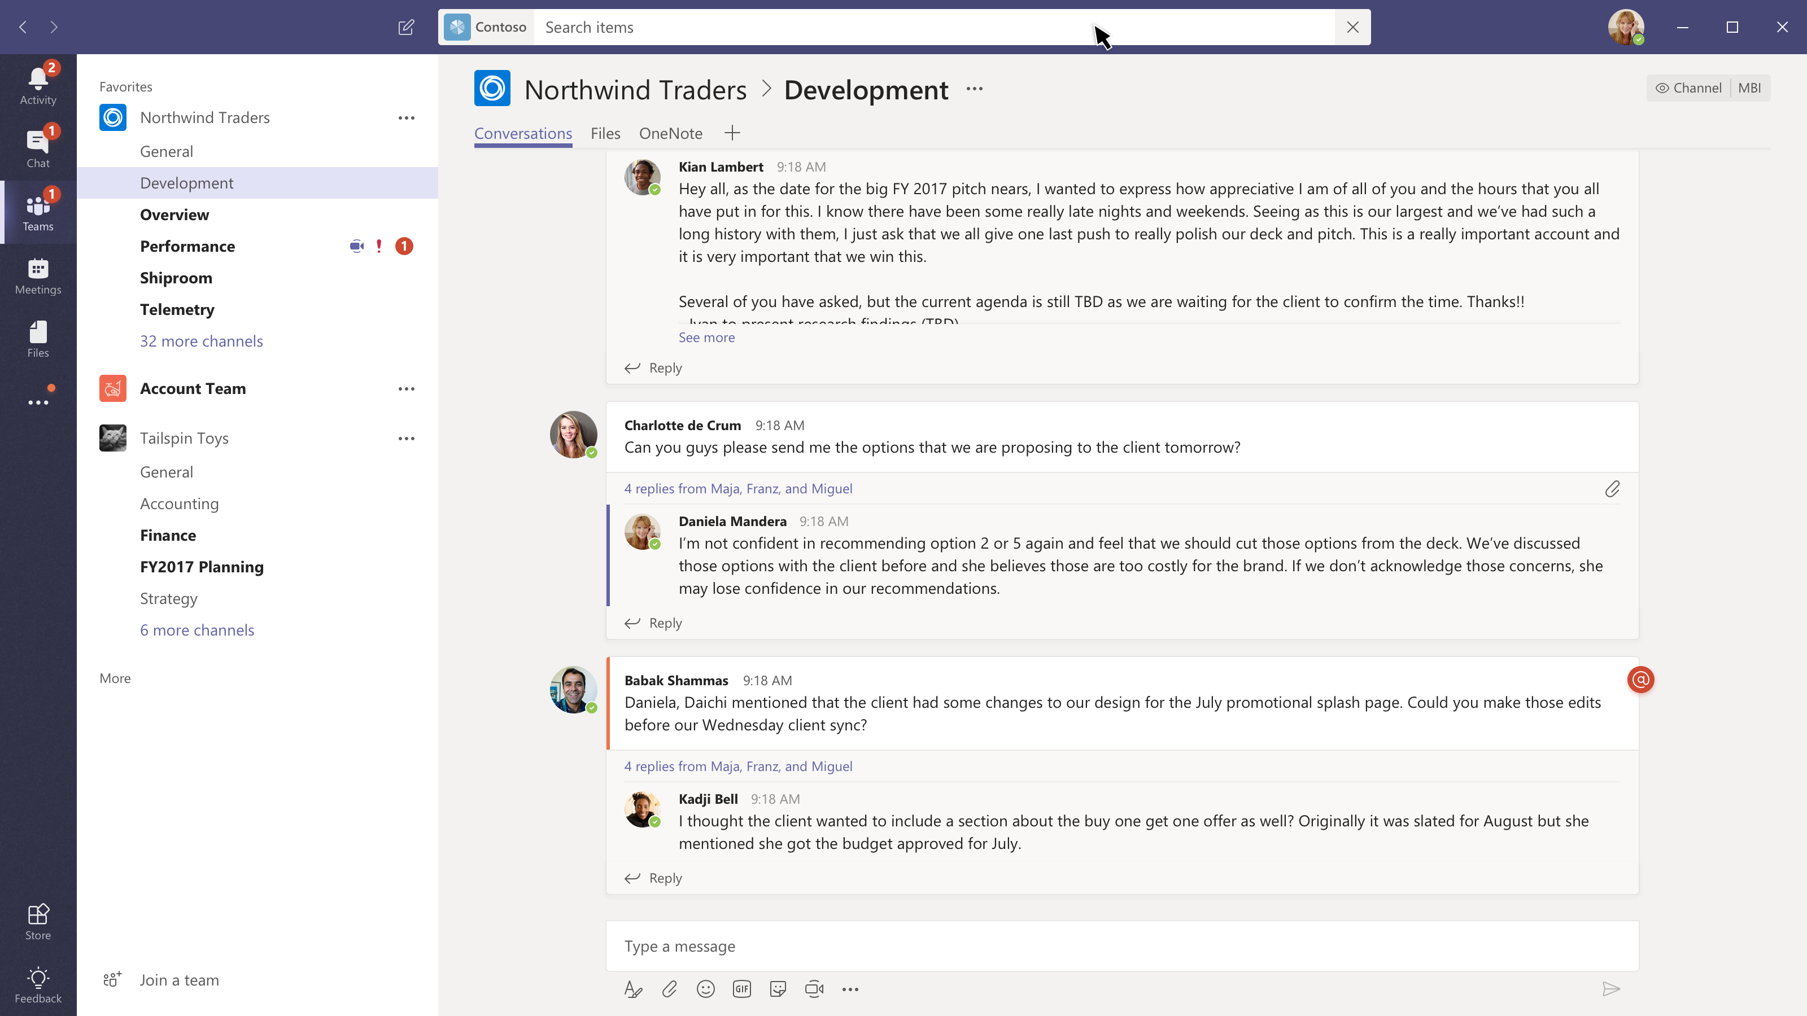

Slide 36
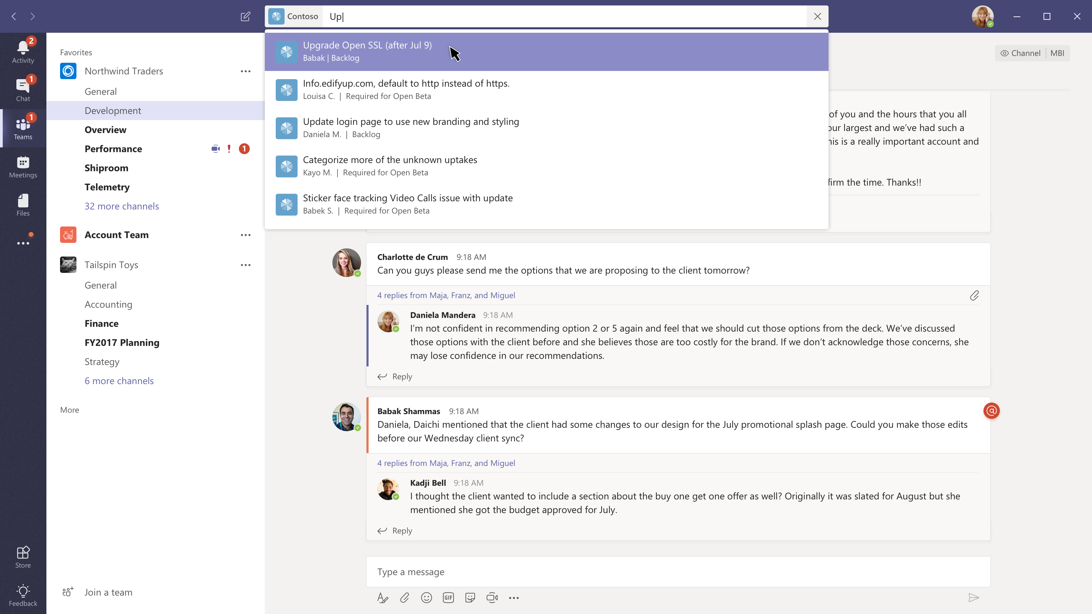

Slide 37
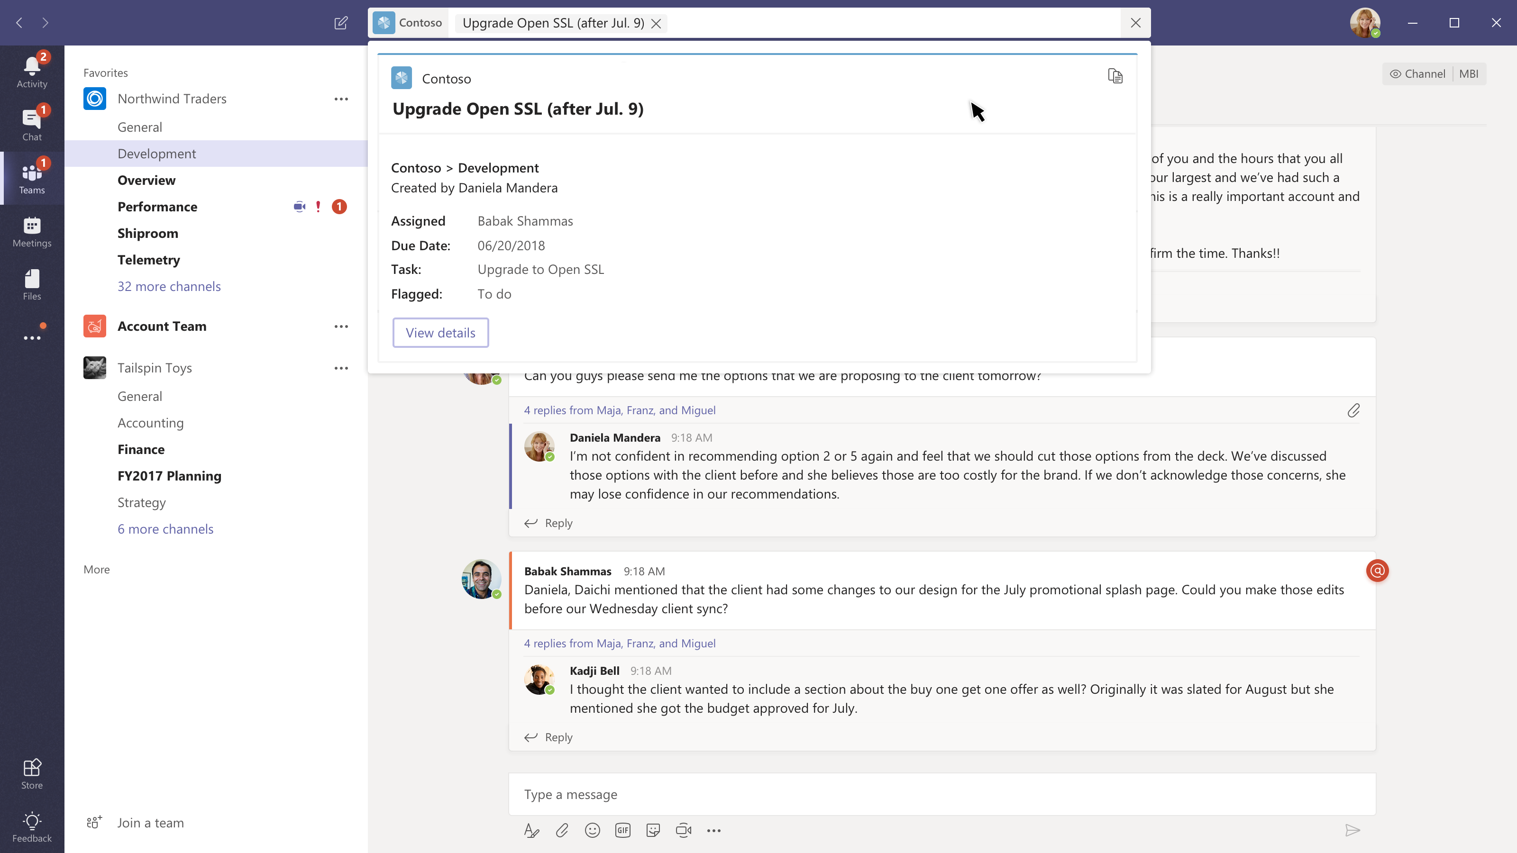

Slide 38
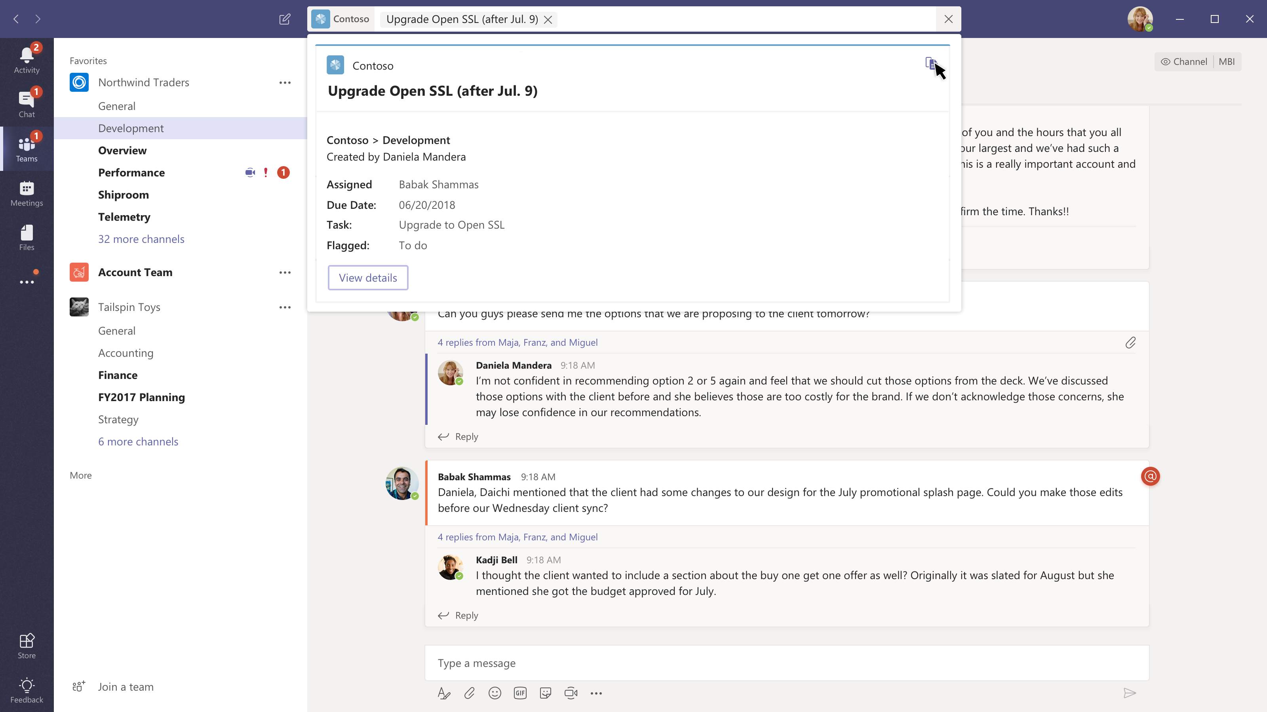

Slide 39
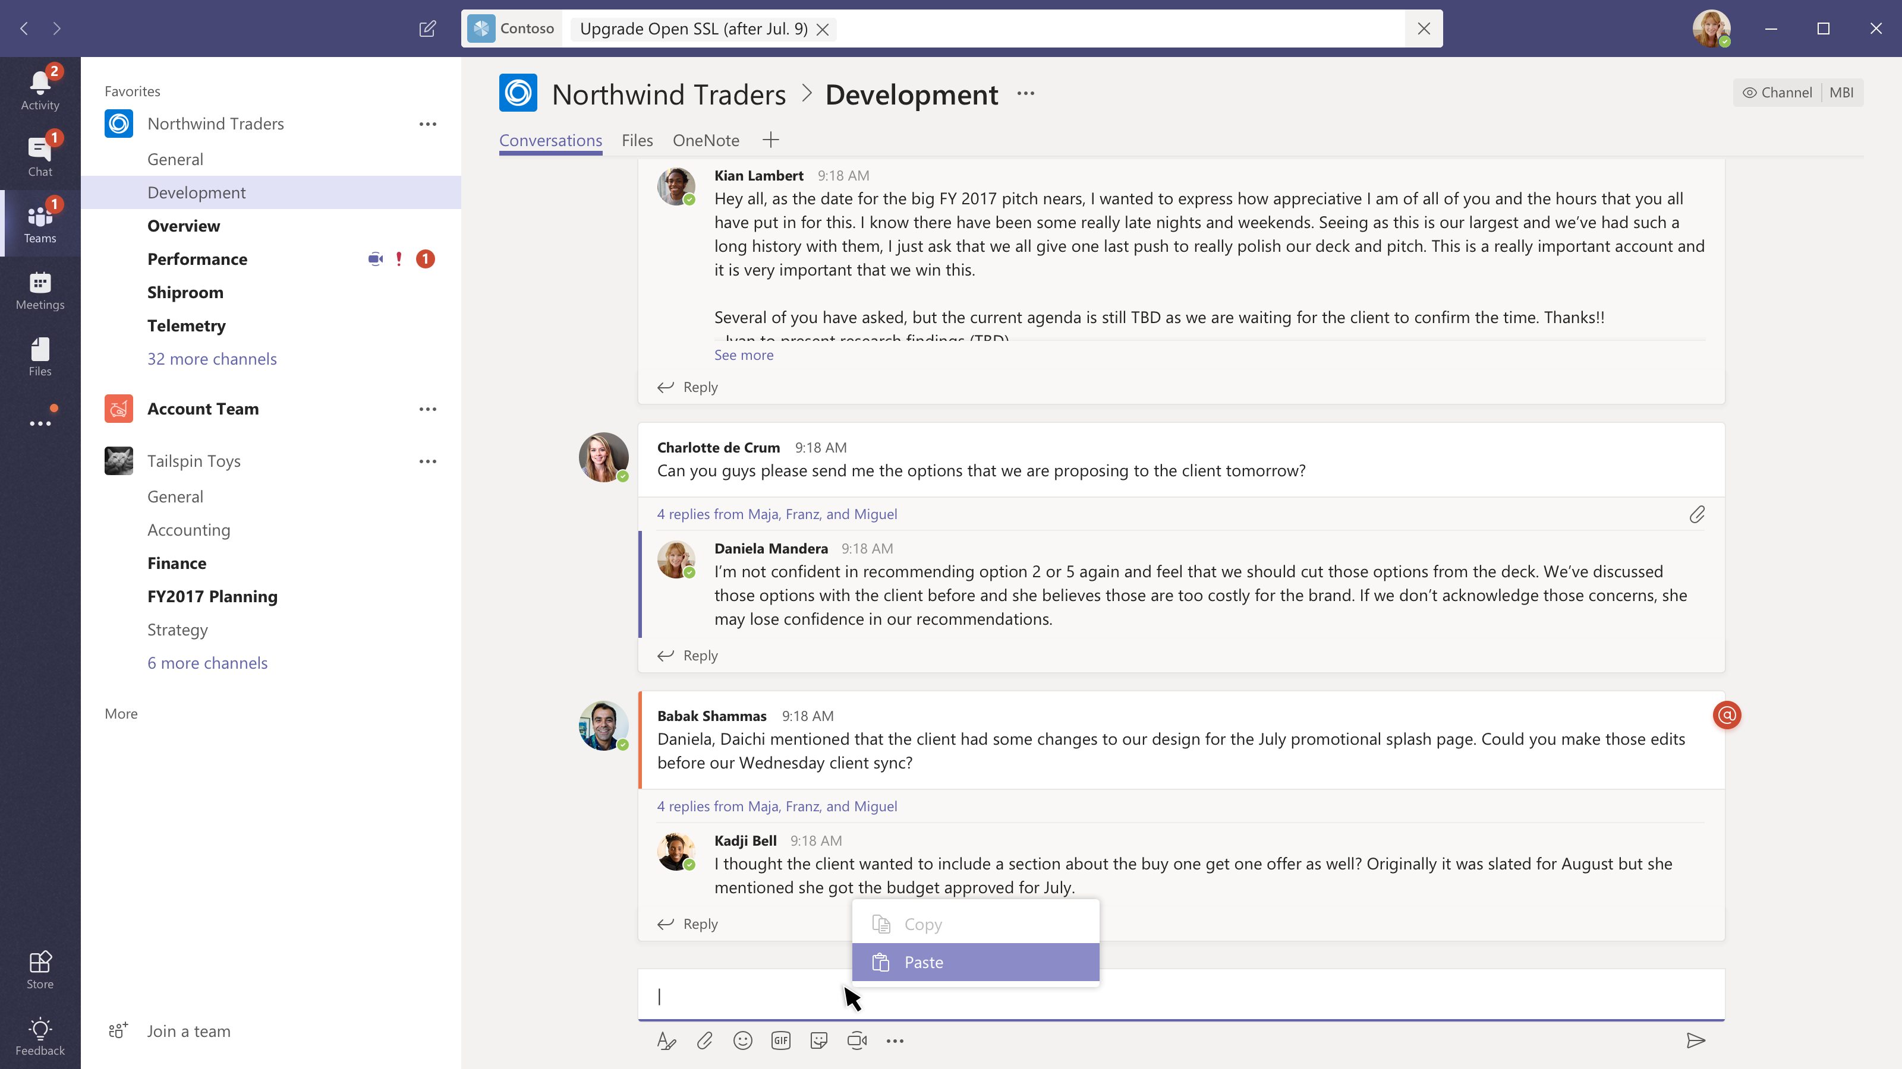

Slide 40
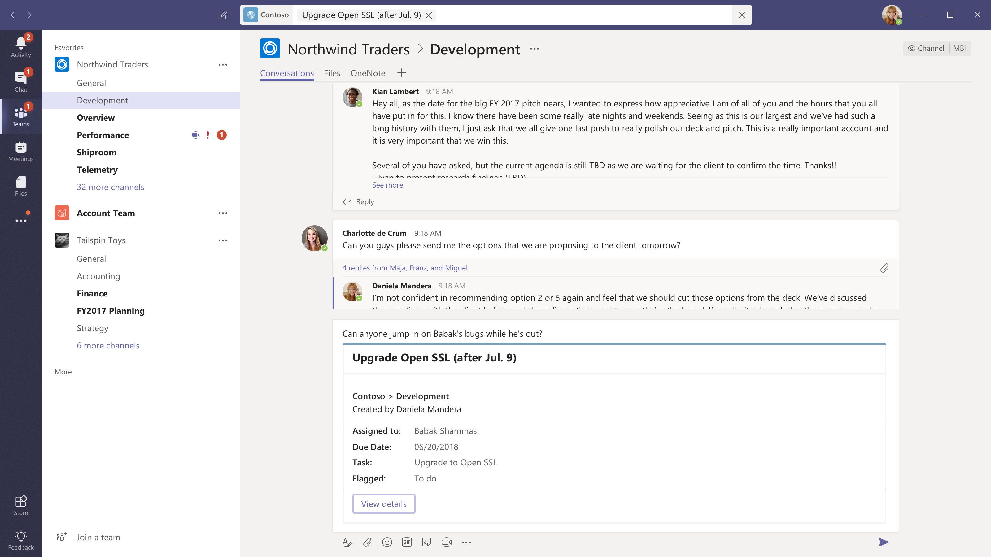

Slide 41
Actionable messages

Slide 42
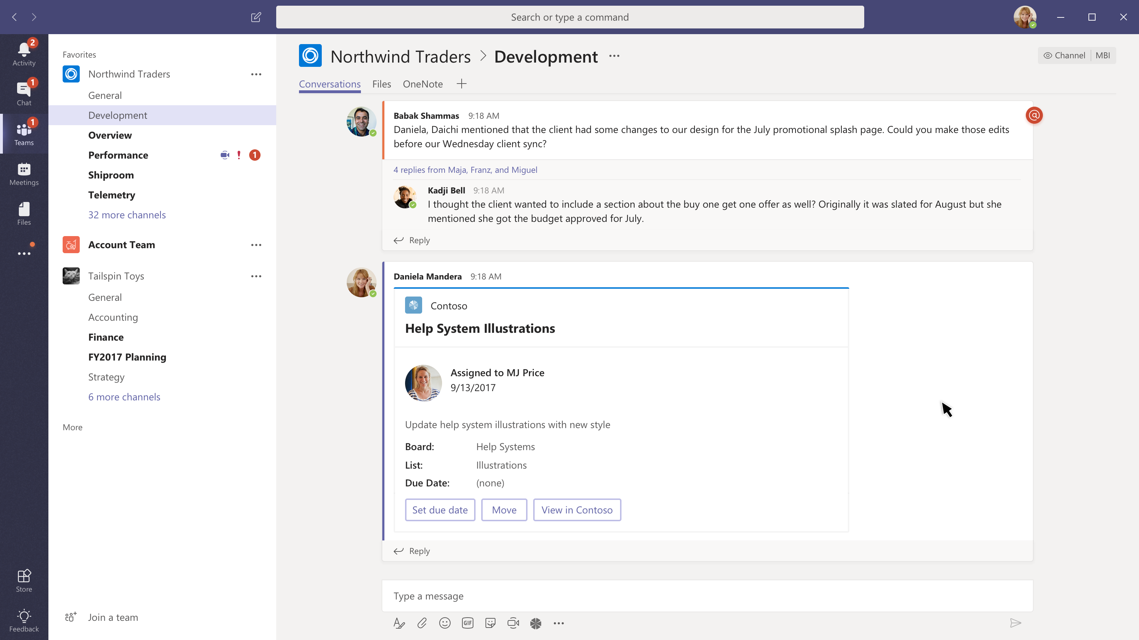

Slide 43
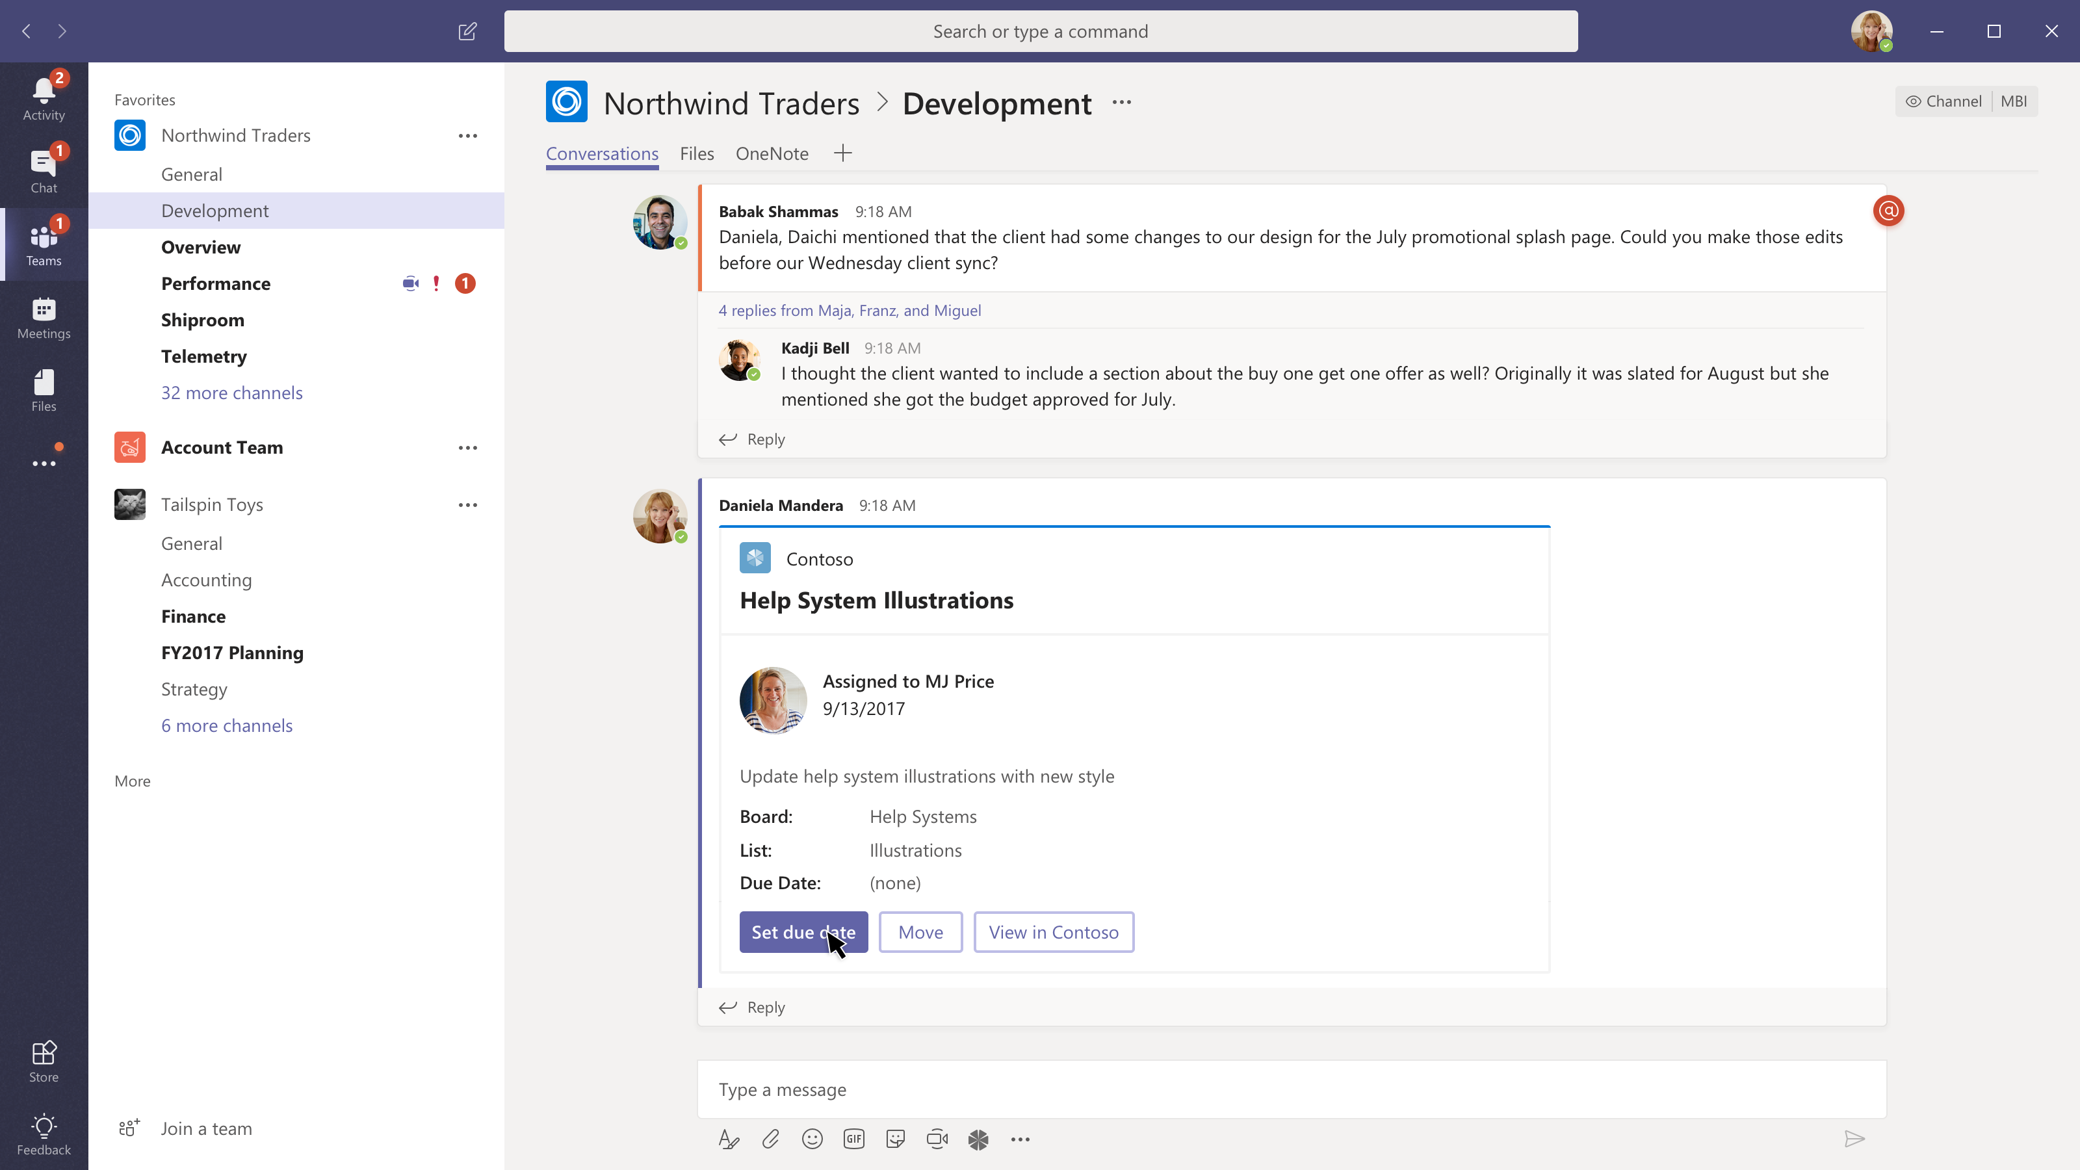

Slide 44
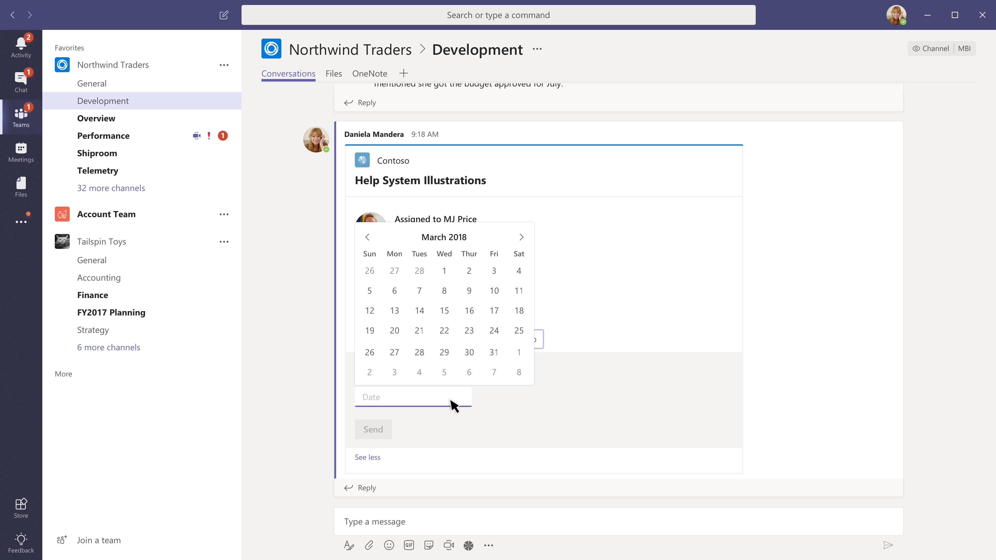

Slide 45
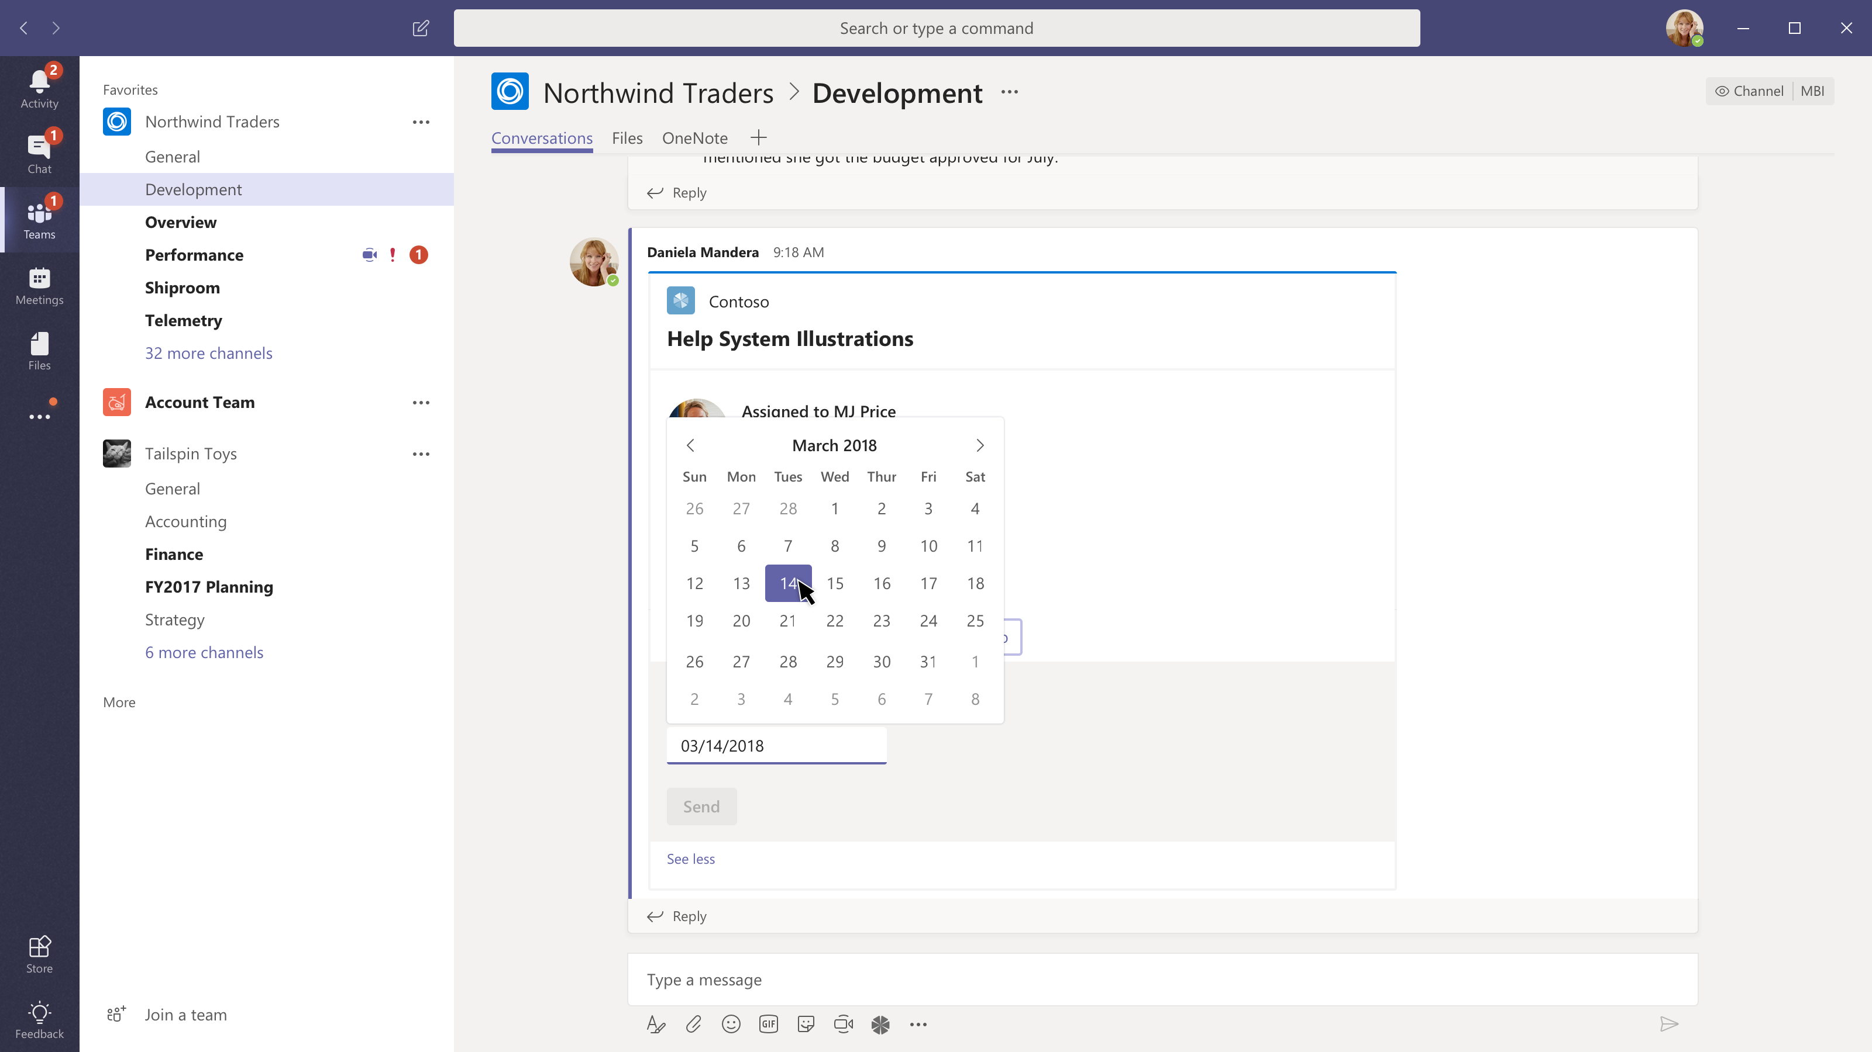

Slide 46
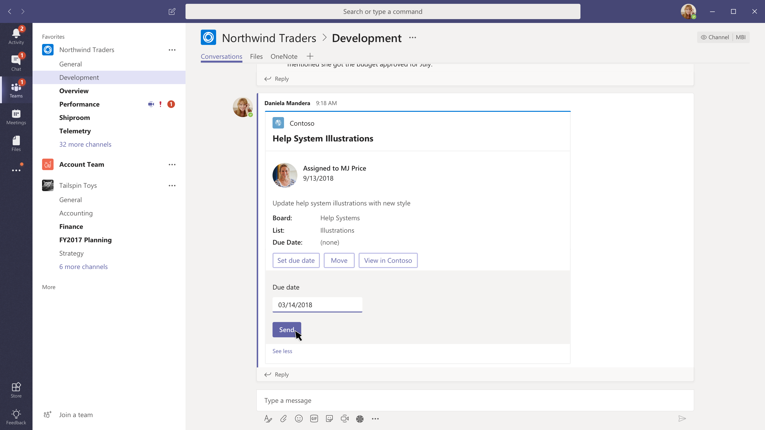

Slide 47


Slide 48
Personal apps

Slide 49
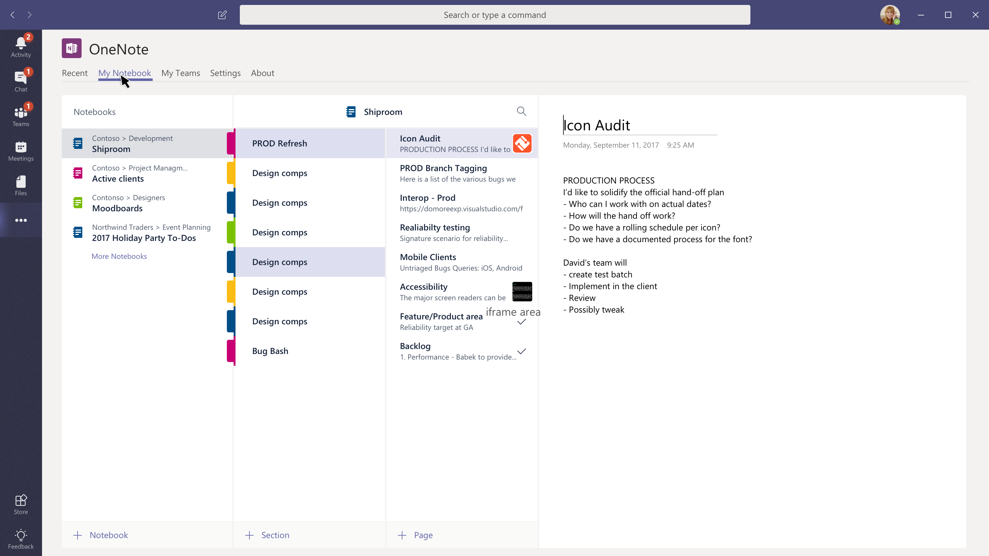

Slide 50
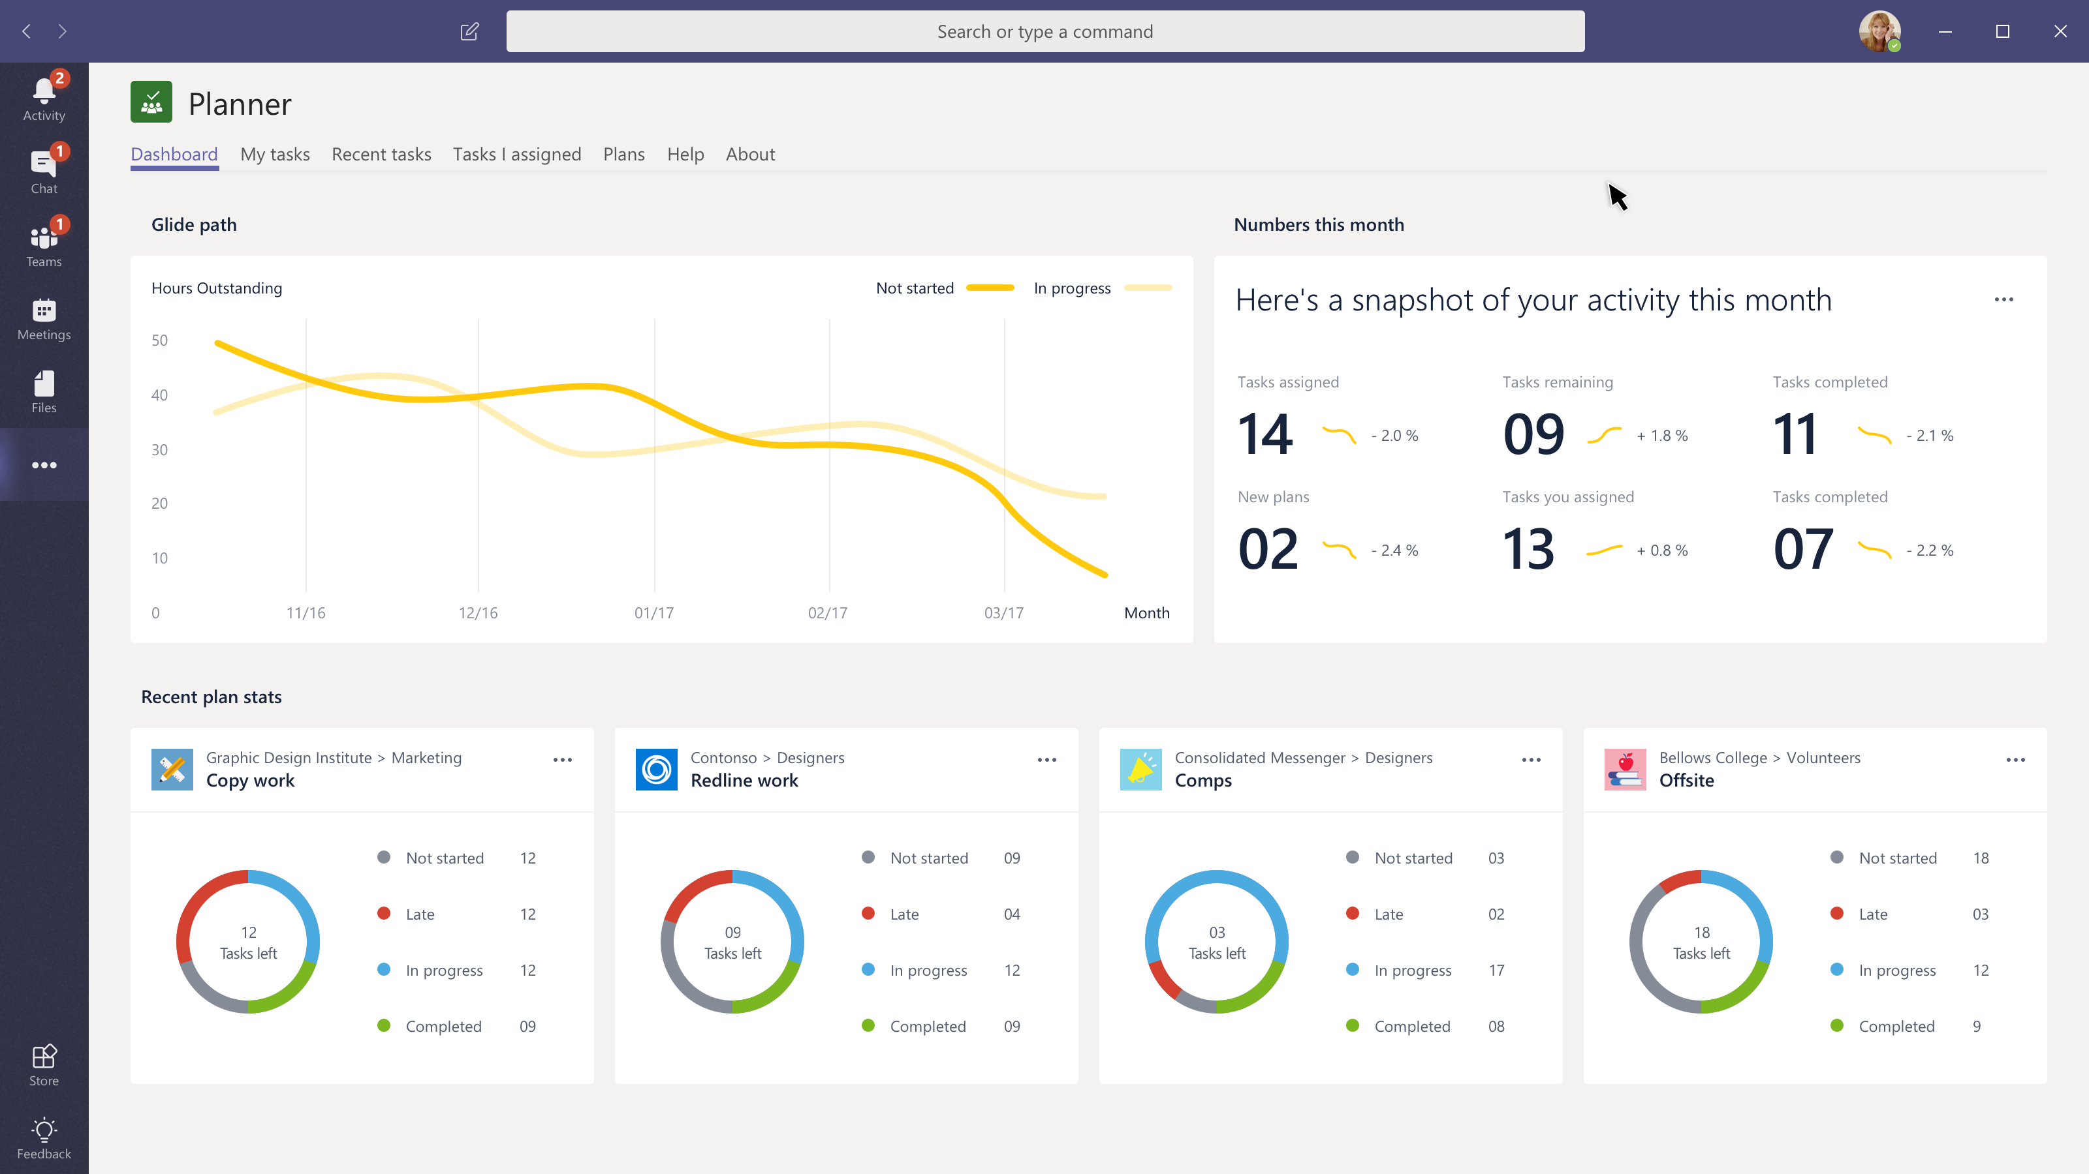

Slide 51
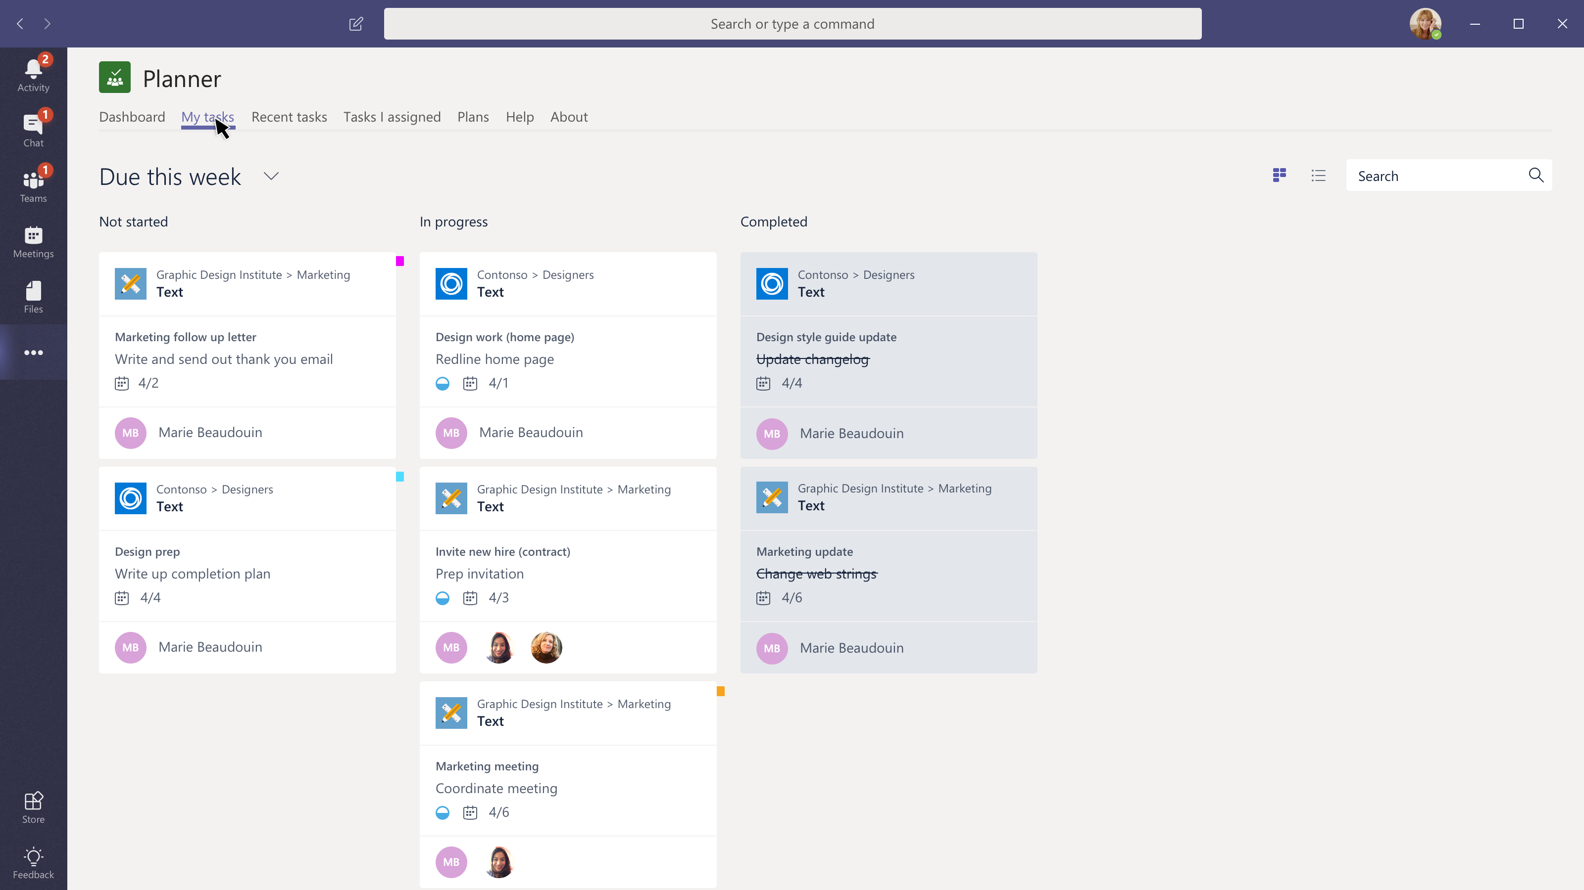

Slide 52
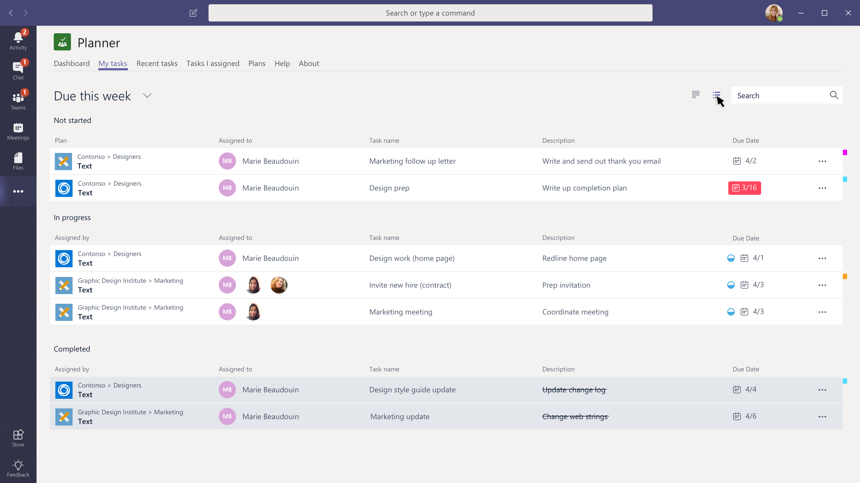

Slide 53
Mobile

Slide 54
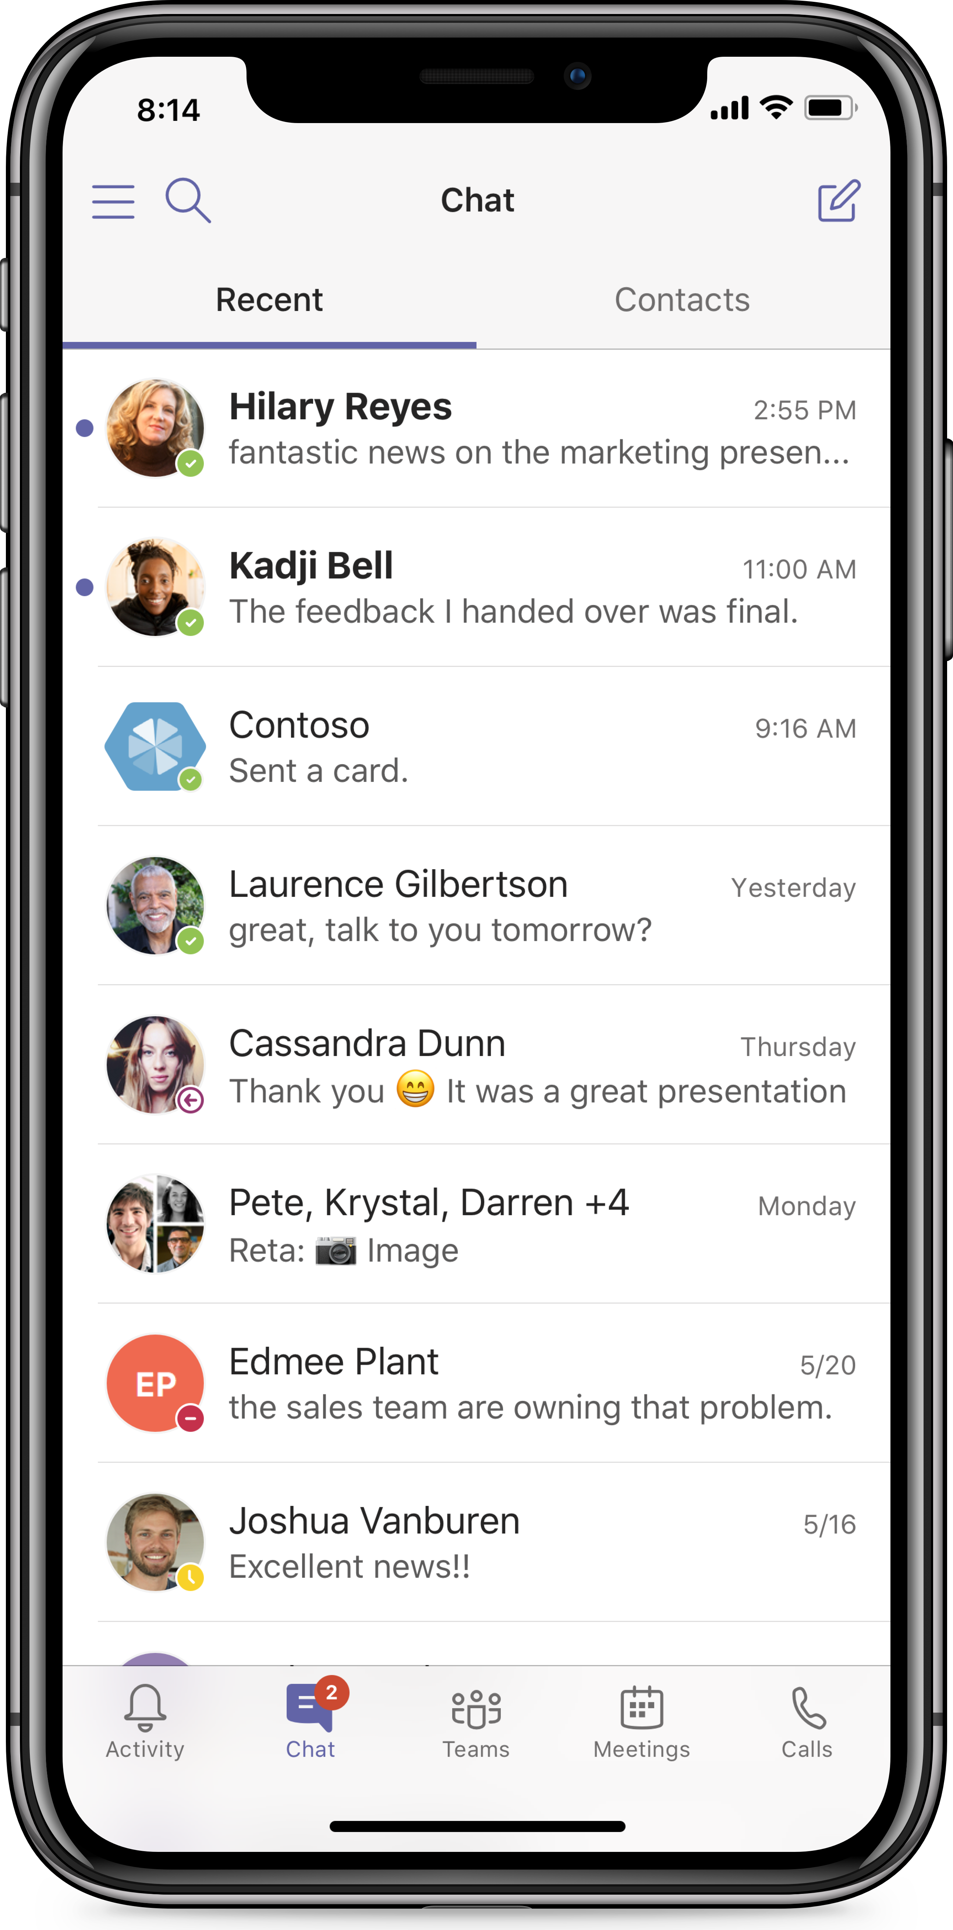
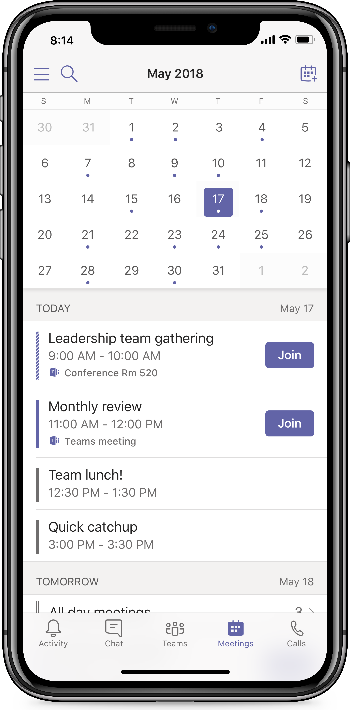
Mobile
Bot conversations, messaging extensions and cards on mobile

Slide 55

Start exploring
Resources
Check out existing integrations already live in the App Gallery (in-app store)
Play around with Teams App Studio, Node.js, and c#/.NET
Understand capabilities of the Teams extensible platform
Brainstorm and finalize scenarios for integrations as a Teams app (tab, bot, messaging extensions, personal apps et al)
Thank you!
Get started developing
Teams Developer Documentation
Teams Sample Code on GitHub
Leverage Teams in-house experts
Discuss scenarios, best practices, and workarounds
Send Microsoft extensibility feature asks

Slide 56
Appendix

Slide 57
Sage People & Microsoft Teams

Slide 58

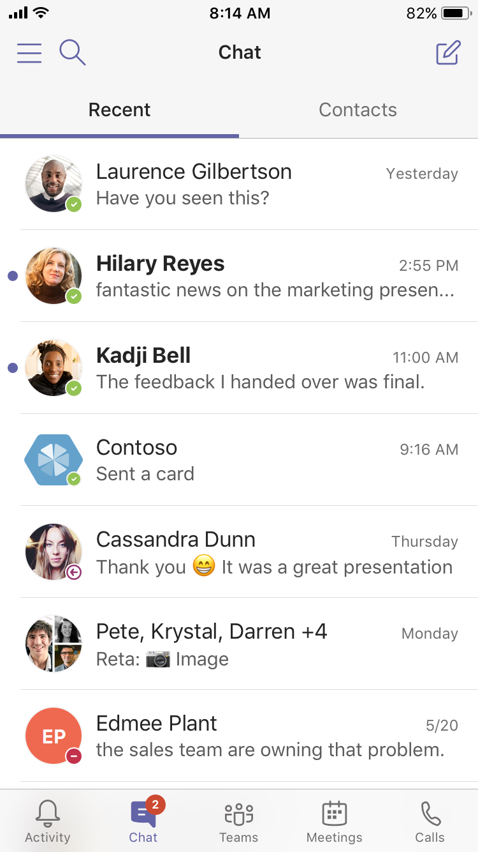
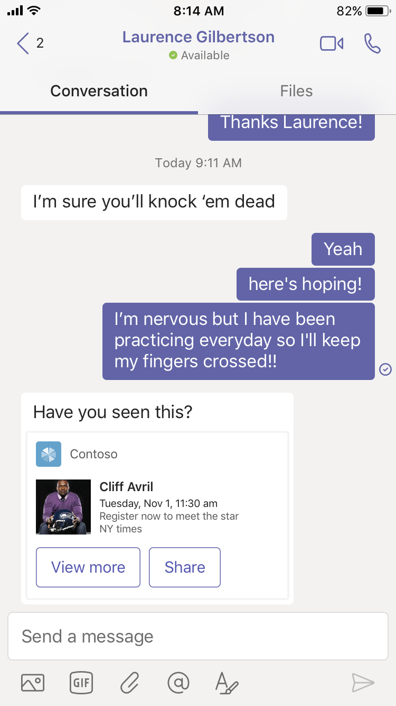
Chat
Bot conversations, messaging extensions and cards on mobile

Slide 59
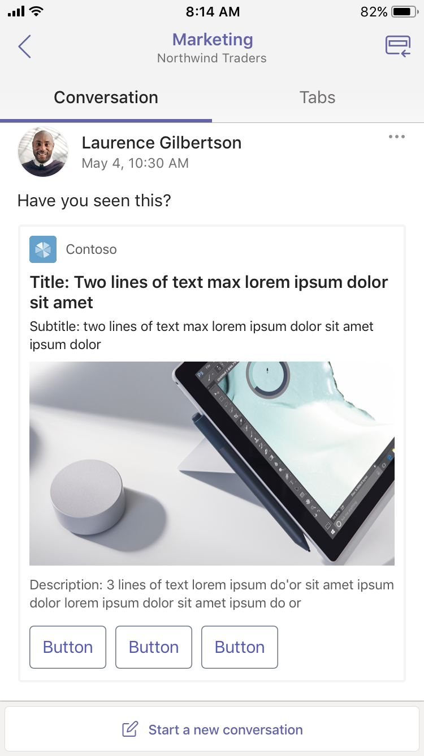
Teams and channels
Bot conversations, messaging extensions and cards on mobile

Slide 60
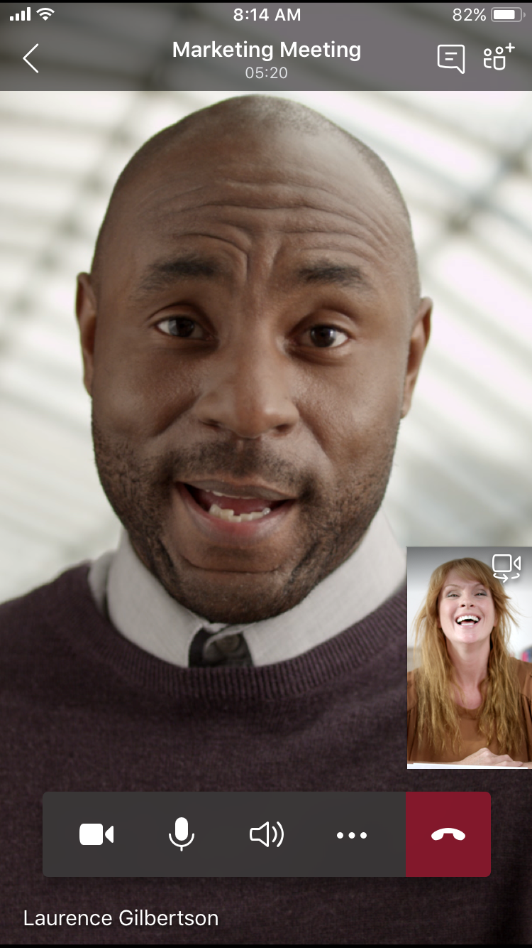
Meetings

Slide 61
Thank you!

Slide 62
Customer Success | J. Walter Thompson
“Our employees have been surprised and delighted with the intuitive interface and the ability Microsoft Teams gives them to mobilize people in a way we’ve never seen before. It’s easy to onboard people midproject, and it works well on a Mac. And like all the other Office 365 apps, we get the structure and security that makes us comfortable with Microsoft cloud solutions.”
Jamie McLellan, Chief Technology Officer
J. Walter Thompson
J. Walter Thompson Case Study

Slide 63
Customer Success | Three
“The real advantage of Microsoft Teams is that you’re more productive because you don’t have to constantly switch between productivity apps. With Microsoft Teams, it’s contextually evident when to use the different Office 365 services—Skype for Business Online to start a meeting, OneNote to organize meeting minutes, and SharePoint Online or Microsoft OneDrive for Business to save your document.”
Gary Walker, Head of People Digital Tools
Three
Three Case Study

Slide 64
Customer Success | Hendrick Motorsports
“We conduct simultaneous tests, sharing and syncing large Microsoft Excel files through Microsoft Teams and SharePoint Online to compare results in almost real time. Now we don’t have to wait until the engineers come back from the wind tunnel to review the data. We refine our analyses of the car’s aerodynamic capabilities on the fly, get more tests done before the race, and build a faster car.”
L.Bryce Whitson Jr., Aerodynamics Engineer
Hendrick Motorsports
Hendrick Motorsport Case Study

